Slide 1
Close-Reading Poetry: An Overview
Purdue OWL
Notes:
Rationale: Welcome to “Close-Reading Poetry: An Overview.” This presentation is designed to help students understand how to perform a close-reading of a poem by breaking the process down into five main steps. The following slides introduce students to some of the major elements of poetic craft, including mode (genre), form, line, and language, and give them tips for recognizing all of these elements.
“Close Reading Poetry” (https://owl.purdue.edu/owl/subject_specific_writing/writing_in_literature/poetry_close_reading.html), another OWL resource, is an excellent companion to this presentation; it models close reading on a Shakespearean sonnet. This handout examines the same elements discussed here in greater detail. For more resources about creative writing, you can visit the OWL’s creative writing content suite: https://owl.purdue.edu/owl/subject_specific_writing/creative_writing/index.html
Directions: Each slide is activated by a single mouse click, unless otherwise noted in bold at the bottom of each notes page.
Writer: Dana Bisignani, 2009
Shifted into new design formatting with minor language/wording adjustments: Matt Del Busto, 2025

Slide 2
Close Reading
This presentation will cover :
What is a close reading?
What is the goal of close reading?
Tips for reading poems
Steps for close reading
More helpful resources
1
2
3
4
5

Slide 3

What is a Close Reading?
A close reading is the careful, sustained analysis of any text that focuses on significant details or patterns and that typically examines some aspect of the text’s form, craft, meanings, etc.
Notes:
Has your literature instructor asked you to perform a close reading? If so, then you should plan and write an essay that offers readers the following (read definition). Basically, a close reading asks you to pay close attention to what the writer is saying and how s/he is saying it.
First, you’ll need to choose a poem at which you want to look more closely.

Slide 4
What is the Goal of Close Reading?
Overall, the goals of performing a close reading are to…
Learn about language and rhetorical technique
Gain a deeper understanding of a text
Explore a specific theme or pattern within a text
Understand how writers craft their work
Notes:
Individual instructors may have different reasons for asking their students to close read a text. Here are some of the most common goals of performing a close reading.
When you read a text very closely, you pay more deliberate attention to how the writer is using language and to the creative ways in which language can work on the page.
Most commonly, performing a close reading can help you better understand and appreciate a text—both its craft and its significance.
You may find yourself interested in a particular pattern you notice throughout a text; exploring it can teach you about how a writer crafts his/her work and how he/she is communicating with us.
Ultimately, learning how texts are crafted will help your own writing; the techniques and creativity employed by other writers can often serve as inspiration for your own writing.

Slide 5

Tips for Reading Poems
When you first approach a poem…
Read the poem slowly
Read it at least twice
Read it aloud to yourself
Annotate important words, images, phrases, and sections
Notes:
Once you choose a poem, you’ll need to read it carefully in order to connect with what the poet is doing. Here are some tips for reading poems. Since not all poems contain narratives (like prose), it can be helpful to approach them a little differently.
Read slowly: if you read too quickly, you’re likely to gloss over important things. Everything included in a poem is purposeful, even small things.
Read the poem more than once: give yourself an extra time through to notice things and get the meaning, or project, of the poem.
Try reading out loud to yourself. It’s often helpful to hear the poems aloud, though not every poem will lend itself to an oral performance. Remember to pay attention to line breaks and white space as you read!
Annotate the text: mark things—significant words, phrases, recurring images, line breaks—anything that seems interesting or unusual to you. Write your reactions or questions in the margins, highlight or underline important passages, etc.

Slide 6
Tips for Reading Poems
If you’re struggling with a poem, also try the following:
Examine your beliefs about what poetry should be or do
Rewrite the poem as a prose paragraph
Read with your gut and your brain
Not all poems are logical and/or narrative
Notes:
Some poems are more difficult than others. If you feel like you’re still struggling to fully understand the poem, try some of the following tricks. First, ask yourself what you believe poetry should be or do. For example, many people think that all poems rhyme, while others believe that a poem should be beautiful (in subject or at least in language). Is it possible that the poem you’ve chosen doesn’t fit your beliefs about poetry? If it challenges any of your beliefs, how does it do so?
If the line breaks make it difficult for you to follow, try rewriting the poem into a prose paragraph. This might make the sentences clearer. This is also a great way to become more aware of the poem’s line breaks—what they emphasize and how the poem’s rhythm and flow change when they aren’t in place.
Last, remember that poetry demands some skills of a reader that prose may not. For example, not every poem tells a story (i.e. is narrative). Some are highly associative and even fragmented. Try to understand what the connections are among images, words, sounds, etc. This helps when you’re dealing with a non-narrative poem. Try to read with your gut and your brain, both the rational and irrational parts of your brain.

Slide 7
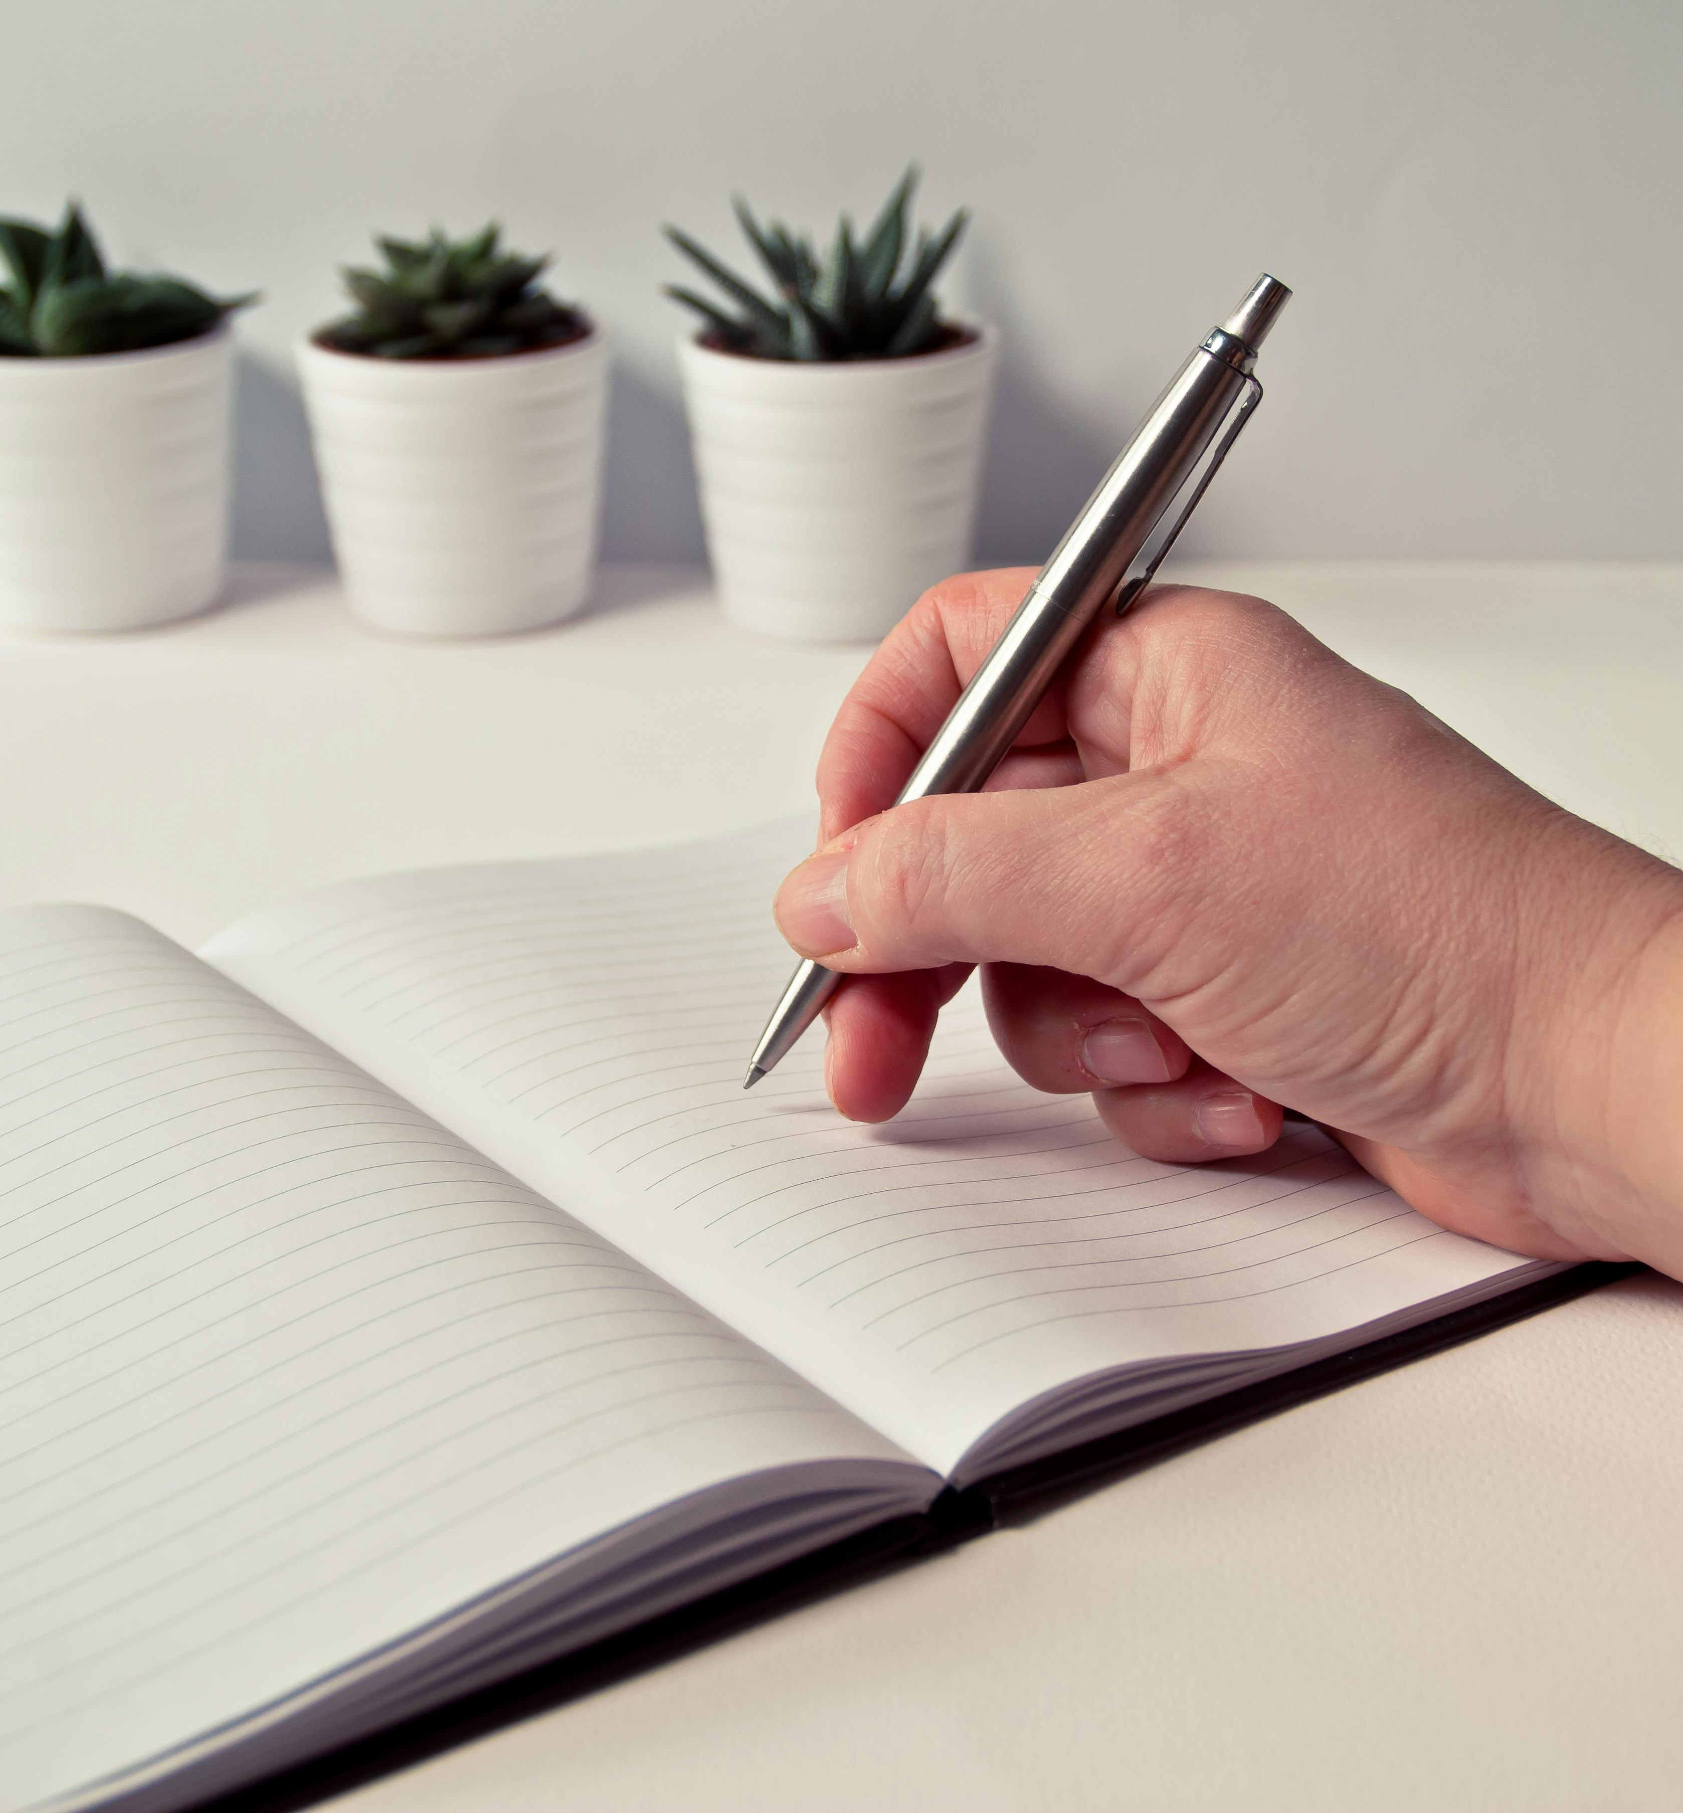
Close Reading: Step 1
Understand the poet’s project.
What subject(s) does the poem address?
Who is the speaker of the poem?
What is the poem’s larger context?
What genre or mode of poem are you dealing with?
Notes:
In order to begin close reading the poem you’ve chosen, you should ask some basic questions to make sure you understand the poet’s project—what s/he wanted to convey in the poem and how s/he wanted the reader to feel or react to the material presented. Determine whether there was a speaker in the poem. If there is, remember that it’s important not to assume that an “I” in the poem is automatically the poet him or herself. For example, the poet Ai writes dramatic monologues in which she speaks in the first person from the perspectives of characters like murderers. If there isn’t an obvious speaker in the poem, is there an omniscient observer?
It’s also important to consider what the larger context of the poem is. When was the poem written and published? Were there any significant historical events taking place at that time? Sometimes it’s also significant to ask what was going on in the poet’s own life (although not every poem is personal or deals with the poet’s emotions). How does the larger context affect the poem? For example, T.S. Eliot’s famous poem “The Wasteland” takes on more meaning and clarity when we know that it was written in response to WWI.
Sometimes it’s also important to understand what genre of poem you’re dealing with. Certain modes, like the ode, for example, or the elegy, have conventions the poet may use or challenge.

Slide 8
Common Poetic Modes
Mode can affect our expectations of a poem and the conventions the poet employs/ alters.
Lyric
Narrative
Dramatic
Elegy
Ars Poetica
Associative, vivid language
Tells a story
Lyric and narrative elements
Laments or remembers
Explores writing as a subject
Notes:
These are some of the most common poetic modes you’ll come across in modern and contemporary poetry, along with brief descriptions of their chief characteristics.

Slide 9

Close Reading: Step 2
Examine the poem’s form and structure.
Use of closed or nonce form
Stanzaic make-up
Devices like repetition, punctuation, or section divisions
Use of negative vs. positive space
How is the poem put together?
Notes:
Next, you’ll want to examine the poem’s structure, or how the poem is put together. Does it have an obvious form or a more organic one? What do the stanzas look like? If you had to describe the layout of the poem on the page, what would you notice about it? Negative space in a poem is most commonly referred to as white space, the space that is not occupied by text. Positive space refers to the poem, or text, itself. We’ll examine some of this in more detail.

Slide 10
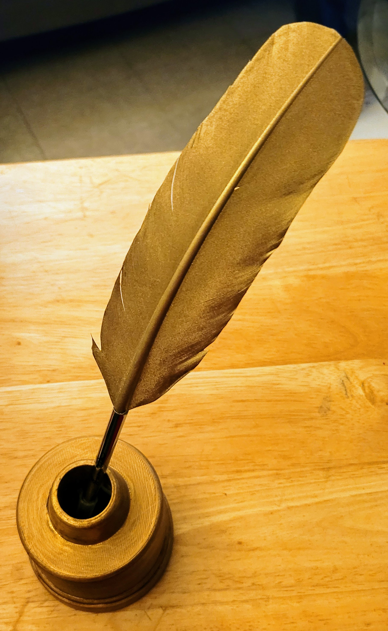
Closed Form
These forms have set rules for the poet to follow:
Sonnets
14 lines
Iambic pentameter
Rhyme scheme: ABAB, CDCD, EFEF, GG
Final heroic couplet
Villanelles
5 tercets + 1 quatrain (19 lines total)
Rhyme scheme: ABAx5, ABAAx1
This Photo by Unknown Author is licensed under CC BY-NC
Notes:
Closed forms have sets of rules that the poet follows. You’re already familiar with some of these, like the sonnet, but there are many. Contemporary poets still use closed forms like sonnets and villanelles, pantoums and sestinas, although they sometimes bend or alter the rules a bit for their own purposes. Using a closed form can place productive pressure on the subject or voice of a poem, and this can sometimes work to the poet’s advantage, especially if he or she is writing about dramatic or difficult subject matter.
If you suspect that a poet is using a closed form, look it up in a book of poetic forms or search the internet. If the poet does not stick closely to the form, why do you think s/he decided to bend the rules? What’s the overall result?

Slide 11
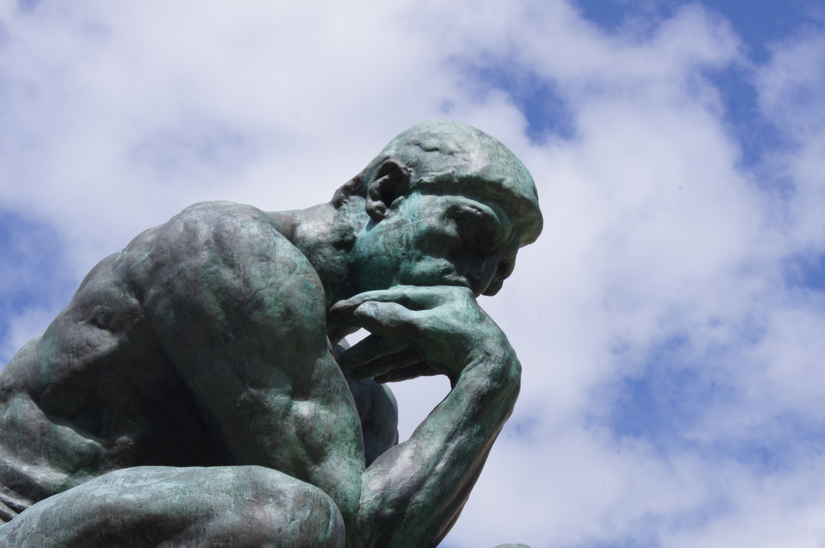
Closed Form
Not sure if the poet used a closed form?
Look for these tell-tale clues:
Number of lines and/or stanzas
Patterns of repetition or regularity
A rhyme scheme
Rhythmic or syllabic patterns (meter)
This Photo by Unknown Author is licensed under CC BY
Notes:
If you’re not sure whether or not the poem you’re writing about is in a closed form, try scanning for these features, which can sometimes clue you in. For example, if a poem has 14 lines, chances are you’ve got a sonnet on your hands. Are there 19 lines, with five tercets and one quatrain? Then you’ve almost definitely got a villanelle. Look for any patterns or repeated elements. These can sometimes help you identify whether or not there is a closed form at work.
If the poet hasn’t used a closed form, you can still analyze the form s/he chose.

Slide 12
Nonce Form
Nonce form refers to any new form a poet creates for a particular poem.
Operate by “rules” the poet creates herself
May seem more irregular at first glance
Can sometimes be highly organic
What does form contribute to content?
Notes:
Sometimes we can simply say that a poem is in couplets or tercets, etc. However, sometimes, the form a poet employs is more complex and original—perhaps he or she has created a nonce (pronounced nonts) form just for this poem. Try to understand what the “rules” are for the poet’s form. Ultimately, what does the form contribute to the poem, and how does it influence to content?

Slide 13
Stanzaic Structure
Stanzaic structures can carry connotations:
Couplets (2) = balance, movement
Tercets (3) = imbalance, religious references
Quatrains (4) = balance, stability
Stanza means room in Italian. Think of each stanza as a room in the house of the poem
Notes:
When you look at stanzaic structure, be aware that some of these can carry connotations. For example, couplets often facilitate quick leaps from idea to idea and make it easy for the poet to be more associative because there is more white space between stanzas. By comparison, quatrains look heavier on the page and are often, though not always, used for narrative poems or poems that tell a story.

Slide 14
More Structural Devices
Repetition
Does the poet use anaphora or refrain? Is there a repeated word or image? Are there words/ideas that echo each other? Example: night, black, dark
Punctuation
Does the poet favor dashes, semi-solons, etc.? Is there a lack of punctuation?
Notes:
Here are some other elements of form worth noting in any poem. Examine the poem you’ve chosen for these features. Does the poet employ any of them?
Anaphora: the repetition of a word or phrase at the beginning of every line.
Refrain: a phrase that is repeated at intervals throughout the poem, as with a song.
If the poet does not use overt repetition, sometimes s/he may use images or words that echo each other. For example, night, black, and dark may all appear in the poem. These words seem to evoke a similar mood, color, and lighting and therefore make echoes across the poem.
As you begin to look more closely at the line level of the poem, pay close attention to punctuation. A poem that has a lot of dashes will have a different tone and rhythm than a poem with semi-solons. Poets like Lucille Clifton often use no punctuation at all. These things can be important clues about the poet’s voice and how s/he wants to reader to read the poem.

Slide 15
Positive vs. Negative Space
Both positive space (the text) and negative space (or white space) make meaning in a poem. White space can:
Emphasize a word or phrase
Give the reader room to pause
Facilitate movement between ideas
Notes:
White space is unique to poetry, since prose doesn’t use line breaks. White space often creates as much meaning as the text itself, and it can clue the reader in as to how the poet wants the poem to be read, including where s/he wants the reader to pause, etc. Sometimes the poet may break a line in an unexpected place to subvert our expectations.

Slide 16
Close Reading: Step 3
Look more closely at line within the poem:
Meter or rhythm within line
Line length and variation
Line break (white space)
Enjambed vs. end-stopped lines
Elements of line can be dictated by form.
Notes:
Line is an important feature in poetry and bears close examination. You’re probably familiar with meter if you’ve read Shakespeare’s sonnets, which are written in iambic pentameter and have a recognizable rhythm. But line length and variation, as well as whether or not lines are end-stopped or enjambed, influence a poem’s rhythm, speed, and flow a great deal. Let’s consider some of these features in more detail on the next slide.

Slide 17

Analyzing Line
What to notice
Meter might indicate a closed form
Line breaks influence flow and speed
End-stopped lines slow our reading down
Shorter lines move more quickly
Look for places where form and line change.
Notes:
As in the case of a Shakespearean sonnet, as we just mentioned, meter can indicate that there is a closed form at work. But sometimes individual lines or sections in a poem can stand out because they are in a strong meter when the rest of the poem is not. Places where rhythm, line, or language suddenly change are important places to pay attention to in any poem.
End-stopped lines are lines in which the end of a sentence coincides with the end of a poetic line. An enjambed line means that the sentence continues on to the next line (i.e. the line break also break sup the sentence). Lines can be enjambed to varying degrees. The more enjambed a line is, the choppier a poem may sound. End-stopped lines tend to slow the reader down since we pause at the end of every line.
If you’re not sure what effect the lines are having in the poem, trying rewriting the poem as prose, or alter the line breaks and read the new version aloud. What changes?

Slide 18




Close Reading: Step 4
Look closely at the language the poet uses:
What kind of diction does the poet use?
What is the tone/mood of the poem?
Which images stand out and why?
Does the poet use figurative language?
Notes:
Now let’s pay closer attention to the language in the poem. Every word choice in a poem is deliberate and can tell us something about the poet’s project, the emotions and/or ideas embodied in the poem, or the subject matter. Start by asking these questions of the poem you’re writing about. Your earlier annotations should help you out here.

Slide 19
Analyzing Language
Diction affects tone
Notice the poet’s diction
Is it Latinate (multi-syllabic)?
Is it colloquial?
Is it formal or elaborate?
Diction affects tone
Example: emerald vs. snot vs. celery
Notes:
Diction means word-choice, and different words have different connotations and different tones. How would you describe the poet’s voice or style? Diction can influence the tone of a poem. For example, if the poet wants to evoke green, s/he may describe something as “emerald,” which has a rather formal, elegant tone. It seems beautiful. On the other hand, something might be “snot” green, which is uglier, more bodily, even a little bratty in tone. “Celery” green is also different. The word seems perky, maybe even a little whimsical.
Again, look for places where there seems to be a shift in tone or diction.

Slide 20

Analyzing Language
Tone affects the mood of a poem
Compare the following lines:
She walked out into the black, yawning night.
She walked through the warm, glittering night.
Notes:
Let’s look more closely at tone for a moment. What is the mood or tone or each of these lines?
The first one seems much bleaker, doesn’t it? Words like “yawning” and “black” make this night seem more threatening. The second sentence seems more inviting. The night is “warm” and “glittering,” which might make you think of stars or even fireflies, pleasant associations.
Hard sounds (-k, -t) often convey a harsher tone than softer sounds like –s and –p.

Slide 21
Analyzing Language
An image can work as an important nexus of emotion and idea in a poem.
What is the tone of the image?
Does the poet use metaphor to alter the image or layer on other associations?
What does the image embody?
Notes:
Not every poem is image-driven, but image is always important within a poem. What are the major images and how are they presented? Sometimes images can embody more than they seem to. Again, analyze the language the poet uses the describe or present the image. Does s/he use any metaphor or other figurative language to alter he image? Because metaphors compare an object or idea to something unlike, they bring additional connotations with them.

Slide 22

Final Advice
The job of the poet is to “make it new.”
Does the poet combine unexpected elements, like form and subject?
Does the poet employ an unusual perspective?
How does the poet’s language make something new or surprising?
This Photo by Unknown Author is licensed under CC BY
Notes:
Now that you’ve examined the poem you’re writing about more closely, think about what the poet does that seems striking or unique. Pay special attention to any places or elements that seem to create tension. For example, in her poem “Daddy,” Sylvia Plath uses a nursery rhyme-like opening and overall rhythm to present very serious, and often disturbing, subject matter. This creates tension that keeps us reading.

Slide 23

Close Reading: Step 5
Make a claim about how the poem works or what the poet is doing (your thesis).
What is the overall effect of the poem’s craft of all the poem’s craft elements?
Where does the poem take us (emotionally, intellectually, narratively, etc.)?
Notes:
Your final step is to make a claim about the poem’s project, some aspect of its craft, etc. In order to support your claim, or thesis, you’ll want to pull evidence from the text itself. Try to offer your reader something new about the poem so that his/her reading is deepened by your careful observations.

Slide 24
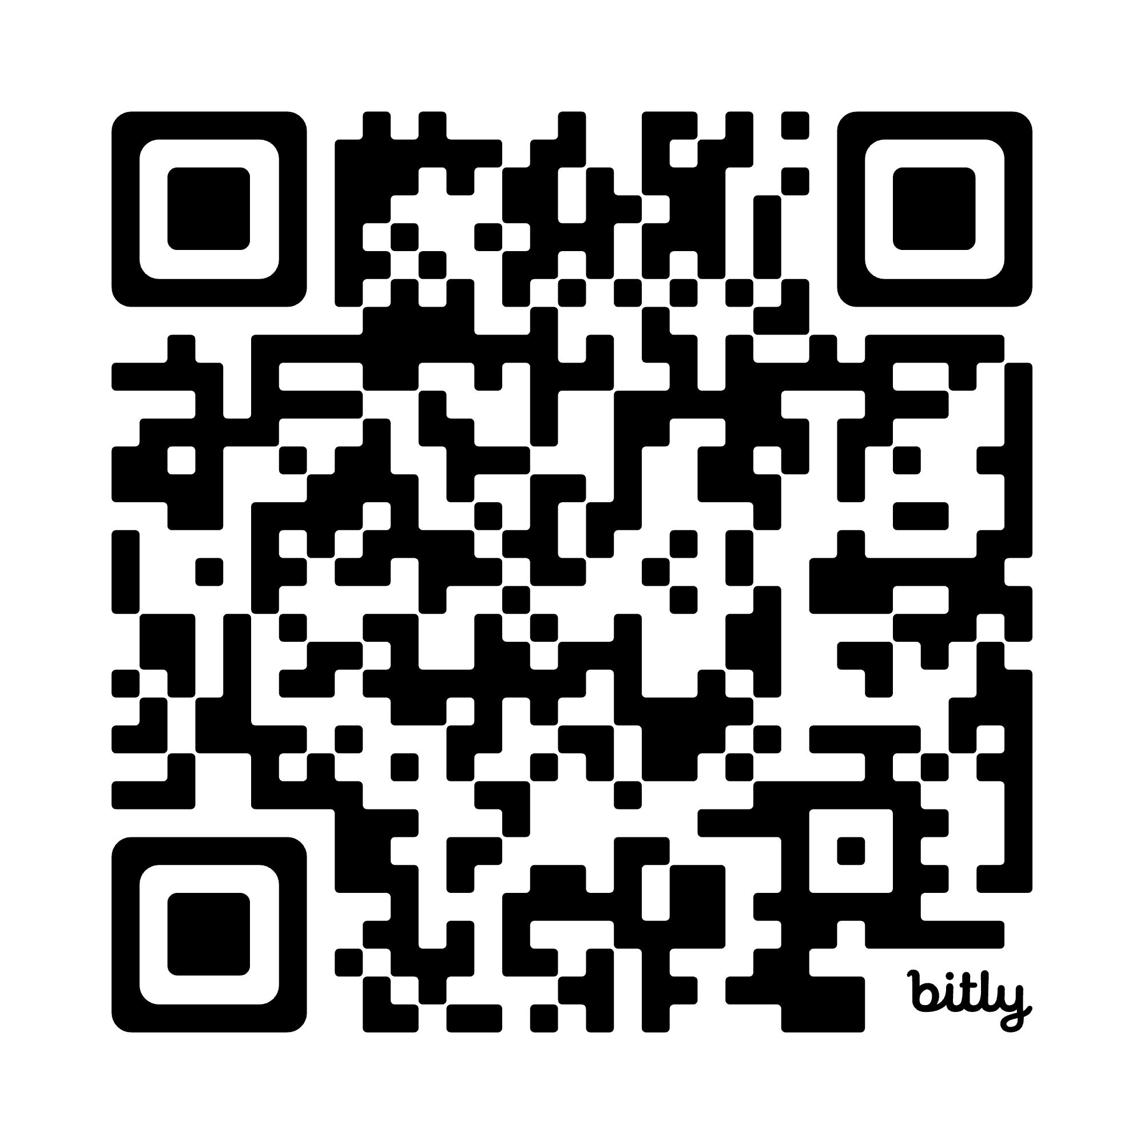
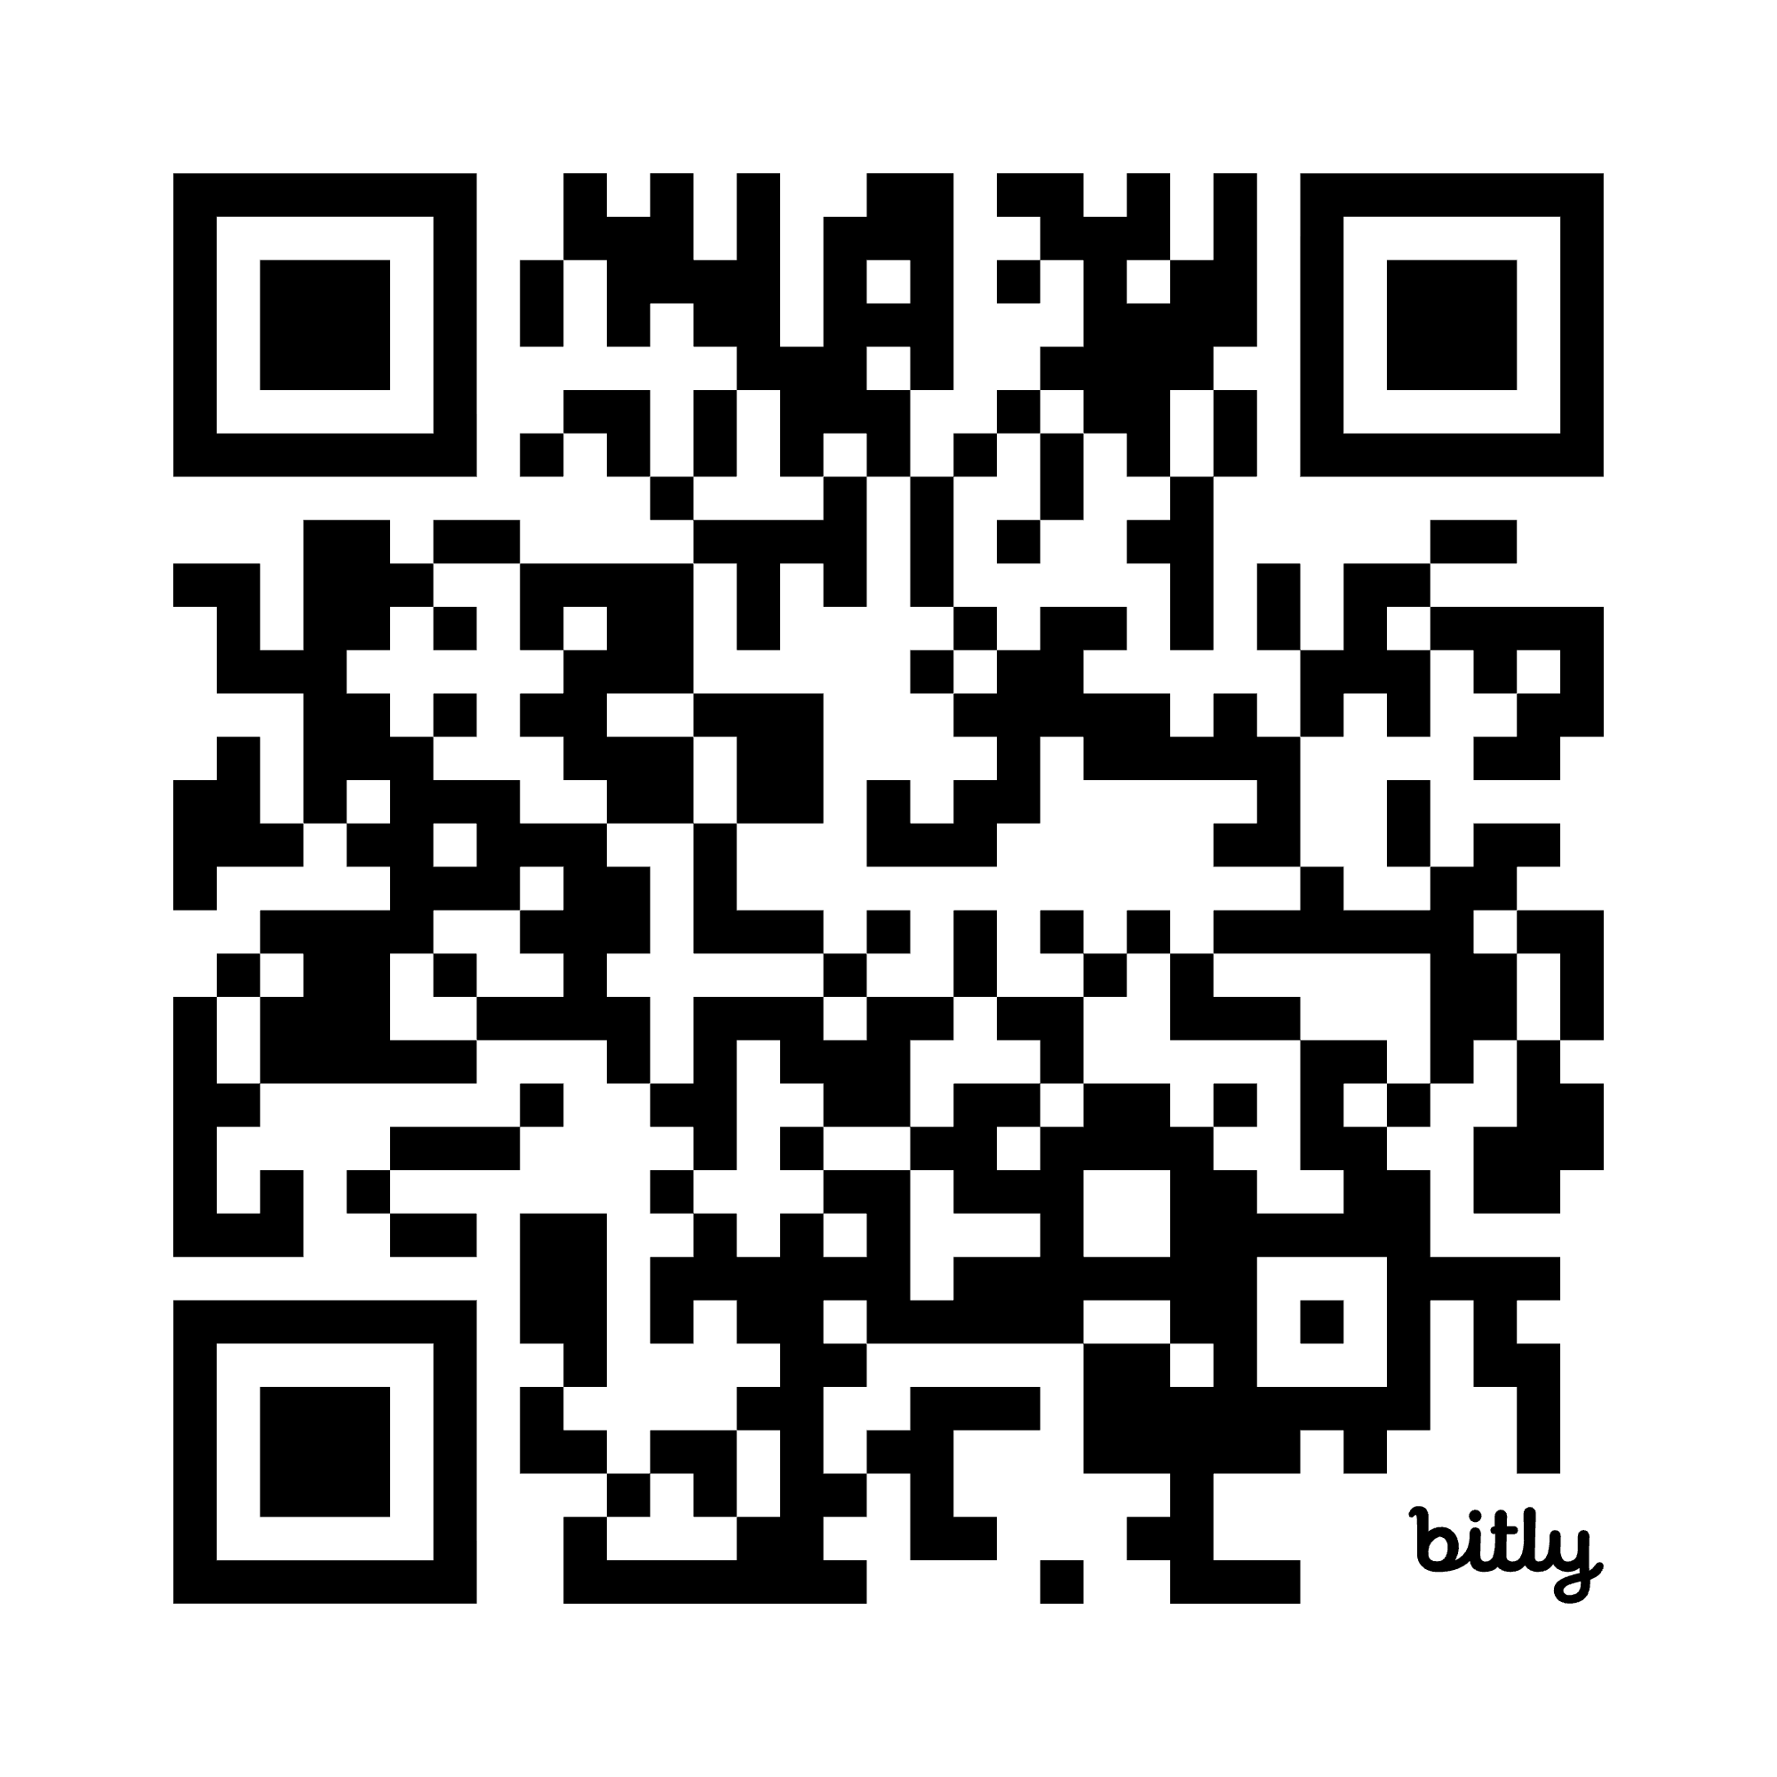
More Helpful Resources
Visit the OWL’s Creative Writing Suite here:
https://owl.purdue.edu/owl/subject_specific_writing/creative_writing/index.html
For more help, you can also visit https://poets.org/text/close-reading-i-cannot-live-you. You will find a sample of a close reading of an Emily Dickinson poem.
Poets.org has examples of other close readings, too.

Slide 25
Thank You
Purdue OWL
Krach Leadership Center
Web: https://owl.purdue.edu/
Phone: (765) 494-3723
Email: writing.lab@purdue.edu

