Slide 1
Working with Creative Writing Students
Tutoring Beginning Poets & Fiction Writers
On-Campus Writing Lab
Notes:
Rationale: Welcome to “Working with Creative Writing Students.” This presentation is designed to introduce writing center tutors and staff to various methods of working with beginning creative writing students. These slides cover some common challenges that both beginning poets and fiction writers may make as well as ways to help these students with their writing. These presentation contains multiple examples as well as a list of helpful advice to give creative writing tutees and resources recommended for creative writing students.
This presentation may be supplemented with an OWL handout, “Tutoring Creative Writers” available on the OWL at https://owl.purdue.edu/owl/resources/writing_tutors/tutoring_creative_writing_students/tutoring_creative_writers.html
Writer and Designer: Dana Bisignani, 2007; updated by Matt Del Busto, 2025
Originally developed with resources courtesy of the Purdue University Writing Lab
Grant funding courtesy of the Multimedia Instructional Development Center at Purdue University
© Copyright Purdue University, 2007; 2025

Slide 2
Outline
This presentation will cover :
Overview of introductory creative writing classes
Common pitfalls for beginning poets
Common pitfalls for beginning fiction writers
Tactics for tutoring beginning creative writers
Advice for creative writers
1
2
3
4
5
Notes:
This presentation will begin with a brief overview of introductory creative writing classes before diving into some of the most common pitfalls that beginning writers face. While it’s possible for creative writing students to be taking a class on genres besides fiction and poetry, such as nonfiction, graphic novels, or screenwriting, fiction and poetry remain the most commonly taught genres within creative writing courses. So, our presentation focuses specifically on working with students writing in these two genres. After discussing some of the challenges writers face within poetry and fiction, we’ll present various tactics for discussing these obstacles with creative writing tutees. We’ll conclude with some general advice that can be helpful for beginning writers.

Slide 3
Overview of Introductory Creative Writing Classes
An intro creative writing course often…
Covers two genres within one semester
  Commonly, this course will be half fiction and half poetry, though some courses might focus on just one genre, whereas others might include different genres (creative nonfiction, screenwriting, etc.)
Introduces students to a variety of contemporary writers
Teaches students to read as writers rather than literary critics
Emphasizes foundational elements of craft
  Poetry: language, line break, form, image
  Fiction: narration, scene, character, setting
Notes:
Creative writing programs at colleges and universities have been expanding over the last few decades. As more students become interested in creative writing, these students may start to take advantage of the writing center to get feedback on their work. While graduate students in MFA programs have a community of other experienced writers with whom they work on a frequent basis, beginning creative writers have mainly their teacher and their class of other beginning writers with whom to consult.
As tutors, most of us are used to working with students on a wide variety of academic and professional writing. However, few of us have had the opportunity to work on a piece of creative writing with a student in the context of the writing center.
First, let’s briefly cover the nuts and bolts of an average introductory writing workshop. This course may vary some depending on your school’s program, but the basic goals are often similar. In many intro creative writing courses, students will write in two different genres, poetry and fiction. Some courses, though, might be just poetry, just fiction, or perhaps a mix of other genres, too: screenwriting, graphic novels, etc. While some students may already think of themselves as “poets,” “fiction writers,” or “essayists,” others will enjoy writing in many different genres or may not have had much experience writing in any one genre just yet.
One of the challenges faced by the workshop teacher is getting students to read works less like literary critics (focusing on theme, social relevance, etc.) and more like fellow writers (focusing on narration, construction, image, line, etc.) Those students who may already be English majors may find this transition difficult.

Slide 4

Creative writing students…
May or may not be English majors
May be taking the course for credit, as an elective, or for fun
Will likely be a variety of years—freshmen through seniors
May or may not be aspiring writers
Have usually not yet experienced a workshop setting
Have often read little or no contemporary writing
Notes:
Creative writing courses, or workshops (as they’re sometimes referred to due to the “workshop” element of the course when students share and offer feedback on each other’s work) attract many different kinds of students, not all of whom will be English majors. Any given creative writing course might have students ranging from the budding novelist who has been writing since elementary to graduating seniors who just need one more class’s worth of credit hours or a student studying STEM with an interest in writing, and so on. For most of them, both sharing their own writing and reading contemporary writing will be new experiences.

Slide 5

The Beginning Poet’s Pitfalls
Uses abstraction more than image
Falls back on cliches
Stays focused on only one subject
Is often sentimental about the subject
Notes:
So, what sorts of struggles might these students face? Let’s begin with the beginning poet. Here are some obstacles commonly faced by those writing poetry for the first time, or by those who are taking their first workshop. The American public, in general, holds many misconceptions about poetry, for example, that it’s always hard and holds a hidden meaning. Few people read poetry for fun. But most people have never even read a contemporary poem, and there are as many different kinds of poetry in America today as there are poets. In English classes, most of the poetry students read will still be primarily from the 18th or 19th century, and this affects what they believe poetry to be. For example, some of the clichés they fall back on may remind you of Robert Frost or even Shakespeare’s sonnets, poets they encountered in high school. Many of them are just beginning to learn what contemporary poetry looks like.

Slide 6
Image vs. Abstraction
Beginning poets often…
Still believe that poetry must be “deep,” mysterious, and difficult
Favor abstract words like “despair,” “pain,” “heaven, or “evil”
  These words are loaded but too general
Notes:
Learning the difference between image and abstraction is one of the most important lessons for a poet to learn. While using abstraction in poetry is not bad, learning to balance abstraction with specific images that have impact on the reader is key to an engaging poem. Beginning poets are often still getting the hang of this.

Slide 7
Image vs. Abstraction
What to tell them:
Specificity = universality
Generality = cliché
Concrete images involve a reader’s senses
Images are more unique to the writer and the writer’s particular experience
Notes:
If a student comes in for a consultation, here’s one way to talk to them about that important balance. The irony: the more specific a poem, the more universal it will be. Even if readers might not have that specific experience described in the poem, they very well may have experienced something that has evoked similar emotions, memories, or ideas. In poetry, too many abstractions and generalizations don’t make poems universal—they just make them bland.

Slide 8
Reliance on Clichés
Clichés…
Hold truth, but have little impact on the reader
Are often placeholders for something the student can’t yet express well
Are general and impersonal
Notes:
Beginning poets are also learning to differentiate clichéd images from new and surprising ones. Description is good, but clichéd description isn’t very compelling.

Slide 9
Reliance on Clichés
Examples of “poetic” cliches:
The lake was a mirror.
Her skin was like porcelain.
The sunset looked like fire.
Cliches can be descriptive but aren’t very surprising or new.
Notes:
Here are some examples. Clichés about nature and the body seem to be particularly hard to overcome because these have been favorite topics of poets for centuries. Encourage students to 1) read poetry to learn what’s already been done, and 2) find new ways to address these topics. Or encourage them to reconsider what they think poems should be about. Poems don’t have to be about nature or love.

Slide 10
Reliance on Clichés
Try altering the language or getting more specific.
Cliché | Possible Revisions
The lake was a mirror. | The lake mirrored the mountains. OR The lake was a bowl of sky.
Notes:
Here are two ways to revise one of those clichés. In the first, that clichéd noun becomes a verb. In the second, figurative language helps describe what the lake is actually reflecting, not just its reflective quality.

Slide 11
Reliance on Clichés
Other ways to help:
Brainstorm images to replace abstractions
What colors, objects, or images evoke “despair” without needing to use that word?
Talke about the emotion or story behind the poem
Examine the “placeholders”
What were they really getting at there?
Notes:
Here are some other tactics for helping beginning poets push past clichés and/or placeholders.

Slide 12
Leave the Triggering Subject
Beginning poets often get stuck. They may…
Describe one thing in detail, then stop.
Write poems that leave you with a “so what?” feeling
Still be searching for subjects that deeply interest them
Notes:
Poems are rarely about just one thing, even though imagery may draw on something specific throughout the poem. For example, an object may trigger a memory, or the weather may seem to be getting at the speaker’s state of mind, or a moment in history. Beginning poets may feel uneasy about leaving what Richard Hugo calls the ‘triggering subject.”

Slide 13
Leave the Triggering Subject
Richard Hugo’s two poetic subjects:
1. Triggering subject: what got the writer started
2. Found subject: what the writer discovered while writing
Encourage poets to free associate subjects, images, and ideas as they write
Notes:
In his book called The Triggering Town, Hugo describes the two subjects of a poem. Talking to students about this concept can help them break out beyond their initial description. Encouraging students to not just write what they know but actually to write into the unknown can be a great thing to do. As Robert Frost put it, “No surprise for the writer, no surprise for the reader.”

Slide 14

Free Association Example
Say a student writes a poem about “autumn rain.”
Ask questions:
  What memories does this subject call up for the speaker in the poem?
  How is autumn rain different from summer rain, spring rain, etc.?
  What does it look, feel, taste, sound, or smell like?
Notes:
Here’s one example. Get the student talking about their project. What did they want to say? Is autumn rain really the subject of the poem, or is it merely a means for them to explore something else? In terms of the rain itself, what memories does it evoke? What makes it specifically “autumn” rain, and what does the rain look, feel, taste, sound, or smell like?

Slide 15
Avoiding Sentimentality
Beginning poets often rely on sentimental language. They may…
Write about personal experiences
1
Write about family or significant others
2
Write the equivalent of a greeting card (with seemingly genuine feeling that could apply to almost anyone)
3
Notes:
Another common obstacle is sentimentality. It’s important to note that sentimentality can go two ways: the language may be too endearing or sweet, or it may be too dark and brooding (think of your stereotypical “teen angst” poem). If students are writing about something or someone very personal, they may have a hard time looking at and writing about the subject objectively. This can cause sentimentality. Greeting cards have their uses, but poetry is almost always best when specific rather than general. We read poems to experience the world through another’s perspective.

Slide 16
Avoiding Sentimentality
Emotion = Good. Sappy = Bad. Encourage students to…
Explore emotion through image
Let emotions be complex, even ambivalent
Steer clear of subjects still “too close to the bone”
Notes:
If a line (or a whole poem) elicit a “That’s so sweet!” response, chances are it’s crossed the line into sentimentality. Here are some things to remind the poet of when discussing revision.
Personal experiences are great material for poems, but encourage students to look at or remember the experience (or person, or relationships) more objectively, to see it from multiple perspectives. (For instance, they could try to write about a relationship or a situation they underwent through another person’s point of view, or even through an object’s point of view, like the lamp in the room that overhead an argument between two friends.) Otherwise, it might be advisable for them to wait to tackle this subject until they have more distance from it.

Slide 17
The Beginning Fiction Writer
Writes more summary/synopsis than scene
Leaves out important detail / description
Tries to convey a moral at the story’s end
Mimics a favorite author too closely
May recycle their plots or subjects
May use language that feels “not their own”
Notes:
Now, let’s look at the beginning fiction writer. Some of the obstacles we discussed in the previous section on beginning poets will still apply, such as the transition from abstraction to image. However, short story writers will face their own obstacles.

Slide 18

Summary vs. Scene
Summary “tells” and moves quickly through information
  Background information
Scene “shows” and takes place in real-time, like a movie
  Important interactions and events
Notes:
Two of the key vocabulary words fiction writers will need to understand are “summary” and “scene.” Both are important, but often, beginning writers have more summary than scene, which prevents the story from being vivid and the reader from becoming really involved in the characters and plot.

Slide 19

Summary vs. Scene
Encourage students to…
Jump into the middle of the action
Capture the reader’s attention in the very first paragraph
Introduce the main character right away
Notes:
Encouraging students to start their stories in the middle of some action can help them become more grounded in scene, rather than summary. If you see places where the writer is getting bogged down explaining things, see if you can get them to turn some of that synopsis into scene.
For more description of summary vs. scene, view the accompanying handout on Purdue’s OWL at https://owl.purdue.edu/owl/resources/writing_tutors/tutoring_creative_writing_students/pitfalls_for_fiction_writers.html

Slide 20
Important Detail
Beginning fiction writers may neglect to…
  Fully describe characters as they enter the story
  Give enough description of the setting
  Break up dialogue with gestures or other details
Encourage students to slow down and describe.
Notes:
Just as beginning poets are learning to incorporate more image, beginning fiction writers often don’t use enough description and detail in their stories. In order to be involved in the story, the reader should be able to clearly see the setting, the major characters, and significant objects (the main character’s car or favorite coffee mug, etc.) There’s even room for description during extended dialogue. For example, we might see a character’s gesture as s/he says something, or something going on in the setting as the characters interact.

Slide 21
Important Detail
Beginning fiction writers often use “the police rundown” to describe characters.
Examples:
  He was six feet tall with brown hair and blue eyes.
  She was so beautiful she could have been a model.
Notes:
One obstacle for beginning fiction writers involves moving beyond “the police rundown” description of their characters. These tend to be generic and don’t help the reader learn much about the character or even see him/her well. Likewise, the second description is also too generic. What made the character beautiful? What color was her hair? How did she dress?

Slide 22

Character Description
Physical description + gesture = better characters
Possible Revisions:
  She had long brown hair that constantly fell in her face. She was always tucking it behind her ears.
  He often massaged the wrinkle between his eyebrows when he was worried or tired.
Notes:
One way to get past this is to mix details about physical description with characteristic gestures. Descriptions that successfully combine these characteristics give the reader clues about the characters personality and help us see the character more clearly. Here are two examples.

Slide 23

Summing Up with a Moral
These stories may suffer from…
Stereotyped characters
Predictable plots
That “after school special” feel
Notes:
Sometimes, short story writers feel their material should convey a moral or lesson by the end. Here are some ways to tell if a student’s writing might be suffering from having an overt moral.

Slide 24
Summing Up with a Moral
Remind students that writing with a moral in mind…
1. Constricts action and character development
2. Limits their audience
The most compelling moments in life are rarely “black and white”
Notes:
Two ways to approach a student about his/her story’s moral is to discuss 1) possibility, and 2) audience. If a student already knows how a story will end before s/he even begins, then they close themselves (and their characters) off to a great deal of possibility. Writing fiction is an organic process. Encourage students to place character development and action before plot; often, interesting plots result from interesting characters in conflict rather than a series of events devised ahead of time.

Slide 25
Working with Writerly Role Models
Encourage students to…
Articulate what they admire about their favorite author’s work
Consider what new perspective they might have on the author’s subjects
Find their own voice, style, and subject matter
Notes:
Sometimes, you’ll find that a student is attempting to mimic his/her favorite author. Having an inspiring author in mind is a good thing, but not if it prevents the student from finding his/her own voice and material. Here are some ways to encourage the student to keep his/her favorite author in mind while still find their own unique style.

Slide 26
General Advice to Avoid
Don’t advise students…
To write only what they know
To write about difficult personal situations before the student is ready to explore them
To show work to their roommates or family members without thought
Notes:
Here’s some advice that’s sometimes tempting to tell creative writers. Restrain yourself. First, many fiction writers do some research on their subjects, and the Internet makes that even easier nowadays. Students should not take for granted what they know and have experienced, but encourage them to use their imaginations to springboard from there. Second, the workshop is an inappropriate place for students to share traumatic or difficult personal experiences. While some students may have enough perspective to use this material in their past successfully, others may not. The workshop, while a creative space, is not the place for narrative therapy. Last, students who show their writing to roommates or family members may not get positive feedback, especially if they’re writing about personal material (or about their families). Or, they may get ONLY positive feedback because the people they are showing it to are so proud of and fond of them as people that their roommates or families are unable to see areas for growth in the students’ writing. It’s generally best for students to find a community of other writers to share their work with. Also, not all families and friends will be supportive of or will understand the writer’s creative endeavors.

Slide 27





Advice to Give
Do tell students…
What inspired a reaction in you as a reader
To read, read, and read some more
To find writers whose work they admire
To write what they see, hear, taste, touch, and smell in every scene or poem
Notes:
Here’s some advice that will serve students well.

Slide 28
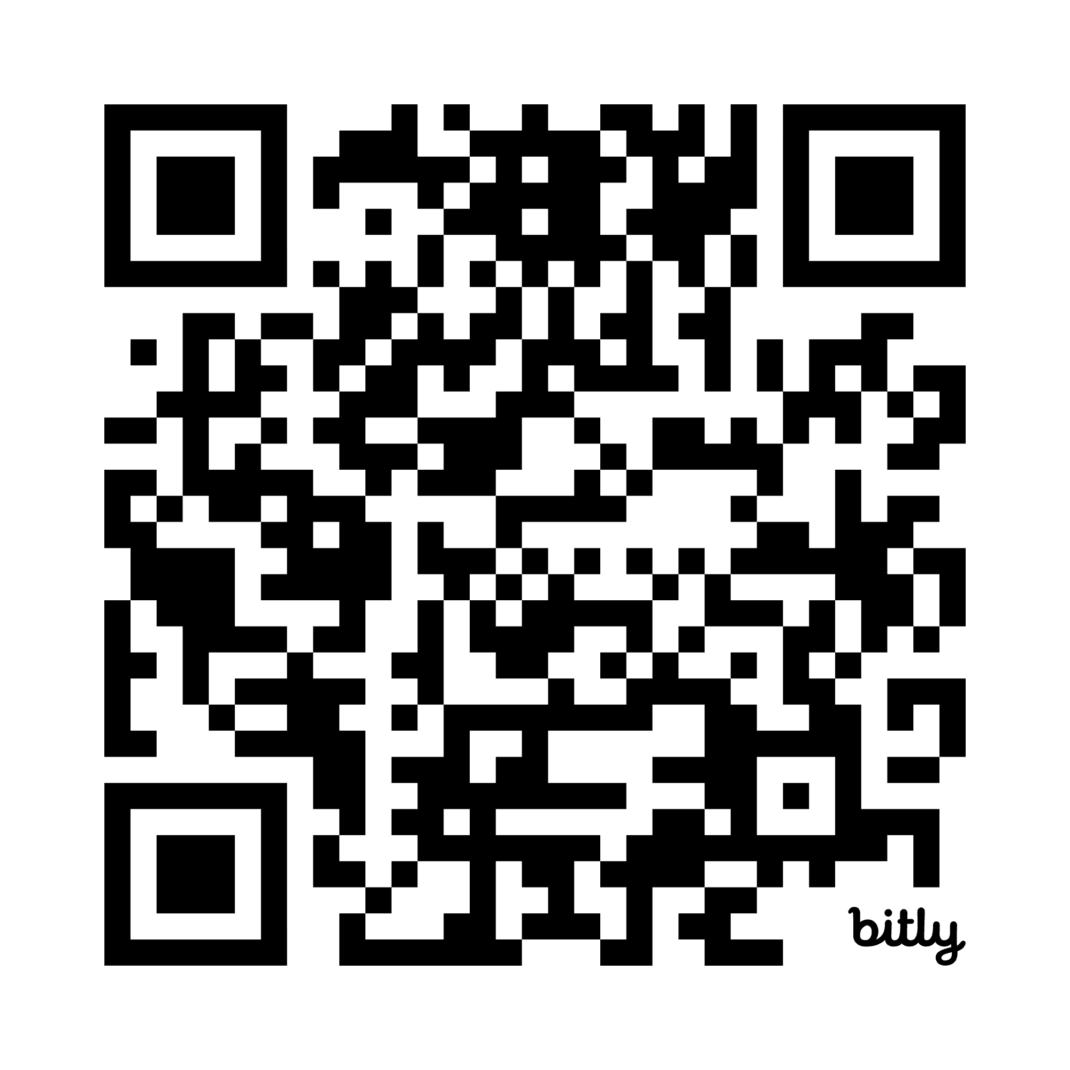
Want More?
Visit the Purdue OWL Creative Writing Webpage and ask the creative writing faculty at your school for more advice!
https://owl.purdue.edu/owl/subject_specific_writing/creative_writing/index.html
Notes:
For a more complete list of resources, including ones geared specifically to tutors, teachers, and writers, check out the Purdue OWL’s Creative Writing Suite online: https://owl.purdue.edu/owl/subject_specific_writing/creative_writing/index.html

Slide 29
Thank You
Purdue OWL
Krach Leadership Center
Web: https://owl.purdue.edu/
Phone: (765) 494-3723
Email: writing.lab@purdue.edu

