Slide 1
Tutoring Resumes
A presentation brought to you by the Purdue University Writing Lab
Notes:
Rationale: Welcome to “Tutoring Resumes.” This presentation is designed to instruct tutors how to help students with their resumes.
Directions: Each slide is activated by a single mouse click, unless otherwise noted in bold at the bottom of each notes page.
Writer and Designer: Stacy Lolkus
Developed with resources courtesy of the Purdue University Writing Lab.

Slide 2
First Five Minutes
Understand the purpose of the resume
  Full-time job, internship, assignment?
  What type of job, internship, assignment?
Find out what parts of the resume have given the student trouble
Focus on these sections
Notes:
Key Concept: The facilitator should stress the fact that if the tutor doesn’t understand the reason the student is creating the resume, he or she could waste time worrying about the wrong parts. Remind the tutors that although students may seem hesitant to make more than one resume, each resume should be tailored to a particular job or assignment to be most effective. A student attending an engineering career fair will have a different resume than someone applying for a specific agricultural job.
The facilitator should stress again and again that it is very important that the tutor is first concerned with the student’s questions. At Purdue’s Writing Lab, tutors only have a 30 minute session to help the student with as much as possible.

Slide 3
If You Have More Time
Format of Document
  Visually appealing
  Consistent
  Bolding and Italics
  Spacing and graphics
Grammar, other mistakes that catch your eye
Work on these ONLY if you have finished student concerns!
Notes:
Key Concept: If the tutor has more time at the end, and the student gives permission, the tutor can then go back and work with some problems he or she noticed through the course of the tutorial.
If a student doesn’t know what to concentrate on, then the tutor can go through the resume and give suggestions.
The tutor should try to worry about the higher order concerns such as format and organization before concentrating on grammar. A lot of times a tutor won’t even have the chance to worry about the grammar in a thirty minute session.

Slide 4
Each Resume
IS DIFFERENT!
Notes:
Key Concept: The facilitator should really emphasize that every resume is going to be different depending on the student, major, job, assignment. The tutor can give as many suggestions as he or she wants, but in the end, the student will be deciding what will be done with his or her resume.
Activity: The facilitator may ask the tutors, “What are some sections that are common in a resume?”

Slide 5
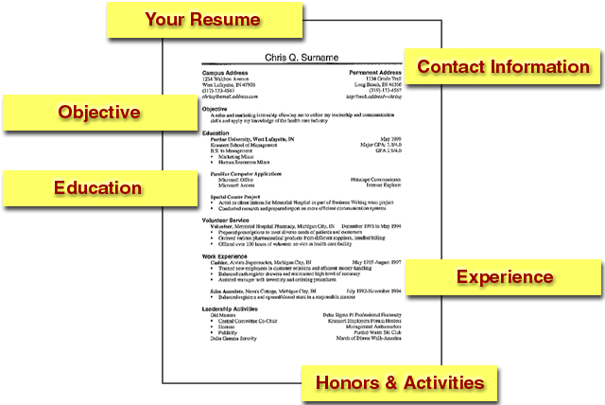
Your Resume
Contact Information
Objective
Education
Experience
Honors & Activities

Slide 6
Contact Information
Cameo Bohnino
Campus Address: Permanent Address:
227 Harrison, Apt. 5 5226 Buckbridge
West Lafayette, IN 47906 Fort Wayne, IN 46815
765.410.6283 260.482.670
cbohnino@purdue.edu
Cell: 765.410.6283
Contact Information
Notes:
Key Concept: This is just one example of a contact information section that is very common for Management students. The contact information section can be different depending what the student wants to put on it.
The tutor needs to make sure that the student at least has:
-a reliable address
-email address
-a reliable phone number
The example above has both a campus address and a permanent address. The student must decide if he or she wants to include both or just one address.

Slide 7
Contact Information Examples
Cameo Bohnino
227 Harrison, Apt. 5
West Lafayette, IN 47906
765.410.6283
cbohnino@purdue.edu
Notes:
Key Concept: An example of contact information without two addresses. This example is formatted on the left side of the page.

Slide 8
Contact Information Examples
Cameo Bohnino
227 Harrison, Apt. 5
West Lafayette, IN 47906
765.410.6283
cbohnino@purdue.edu
Notes:
Key Concept: Another example of contact information with one address. This example is centered in the top middle of the page.

Slide 9
Objective Statements
Two different approaches to objective statements
  Brief and to the point
  Detailed description of desired position and qualifications
Student has to decide which approach is best
Notes:
Key Concept: The facilitator should emphasize that the objective statement is sometimes considered the hardest part of the resume. Different people have different ideas about what objective statement approach is appropriate to use. Some recruiters say that objective statements are useless and if the student has an objective statement at all, it should be brief and to the point.
Other recruiters argue that they just scan the objective statement when they are initially considering applicants. If it doesn’t stand out, a student could be rejected even before the activities and work experience are taken into account. If this is the case, objective statements should be longer and more descriptive.
If the resume is for an assignment, the student should follow the teacher’s guide to objective statements. But if the resume is for a job, the student must decide which approach would work best for his or her resume. Not every recruiter is going to have the same view on objective statements. The student must choose a method where he or she feels most comfortable.

Slide 10
First Approach: Brief
To obtain a summer internship in sales/marketing at Owens Corning
A full-time position as a system analyst
A summer internship as a project engineer
Notes:
Key Concept: The first approach to objective statements is very brief and to the point. With this method, the student should only put the position and time length he or she desires. If the student knows the particular company, that can also be added. This type of objective statement is easy to read and pick out right away the student’s interest.

Slide 11
Second Approach: Descriptive
A summer internship in a sales/marketing position at Owens Corning where I can employ my team building skills and versatility to create new ideas
A full-time position as a systems analyst which will allow me to use my programming, technical writing, and supervisory skills to lead a group of dynamic employees
A summer internship as a project engineer with a construction company that will utilize my experience in field engineering, cost controlling, and estimating
Notes:
Key Concept: A descriptive objective statement gives employers a glimpse of the student’s qualifications. This type of objective statement is sometimes very difficult to help a student develop. Tutors can ask students questions about what type of job they are looking for, or go on websites and pick key words off of the job or company description.
Goals of a descriptive objective statement:
1. Summarize student’s qualifications for a specific position
Attract the employer’s attention
Introduce the rest of the student’s resume
The descriptive objective statement is a little like the thesis statement of a paper, it defines the purpose of the rest of the document.
Should include briefly:
Length of position
Job Title
Field or industry
Relevant skills and qualifications
This type of objective statement is harder to read, but pinpoints specific skills and gives more detail.

Slide 12
Education
Bachelor of Science in Management December 2007
Purdue University, Krannert School of Management, West Lafayette, IN
Minor: Marketing
Current Overall GPA: 3.5/4.0
Notes:
Key Concept: The education section should be first on the resume after the objective statement, because usually employers are most concerned with this section. It should contain the university the student attends along with the student’s major, minors, expected date of graduation, and relevant educational classes the student has taken to make him or her valuable to the position.
This section can also contain computer skills, language skills, courses or projects taken. If the student decides to add computer skills, Microsoft Office is not needed since most college students know how to use Microsoft Office.
The facilitator should emphasize that the tutor make sure the student has which campus the student attends, and also the scale of the GPA. A 3.0 out of 5.0 looks a lot worse than a 3.0 on a 4.0 scale!
A lot of students have questions on how low is too low for GPAs. Usually if a student has below a 3.0, it shouldn’t be included. If the student’s major GPA is higher than the overall GPA, that can be used instead. The student can carry out the GPA to two decimal points (3.55), but that is the maximum.

Slide 13
Work Experience
Server May 2003-June 2006
The Blu Tomato, Fort Wayne, Indiana
  Provided customers with superior service and ensure their comfort in an upscale restaurant environment
  - Achieved net sales averaging between $400 and $750 a night
Swim Coach Summers 2004-2005
Blackhawk Swim Team, Fort Wayne, Indiana
  Improved the swimming skills of children ages 4-18 while encouraging
  the children to stay on task
  - Constructed line-ups for a competitive advantage at swim meets
Notes:
Key Concept: This is an example of a very standard work experience section. The tutor should make sure that the student is including the position, location, dates, and a brief description of each job. Each description should be parallel, and each job should be set up the same as the previous job.
The jobs that are included in the students’ resumes should support the jobs they are looking for. If a student is applying to a teaching job, he or she doesn’t need to include a serving job unless the student wants to emphasize certain skills that are valuable to teaching in the serving job.
If the student worked for a significant company or organization and would rather highlight the company than the position, the student can bold the company or put it before the job title.
Jobs should be listed in either reverse chronological order or in order of importance. Anytime anything quantitative can be included, the student should include the information so employers have a better way of measuring the student’s skills.
Activity: The facilitator can hand out examples of weak job descriptions and the tutors can break into groups and expand these descriptions.

Slide 14
Experience
Purdue Athletic Promotions, West Lafayette, IN April 2004-Present
Manager of Promotions for Purdue Swimming and Diving
Create and implement a promotional campaign to increase attendance at swimming and diving events
Design advertisements for newspapers, radio, and campus
Blackhawk Swim Team, Fort Wayne, Indiana Summers 2004-2005
Swim Coach
Improved the swimming skills of children ages 4-18 while encouraging the children to stay on task
Constructed line-ups for a competitive advantage at swim meets
Notes:
Key Concept: Although a lot of students usually just list their actual paid jobs in the work experience section, the tutor can also stress to the student that if he or she was involved in a significant club or activity, this can be included in the experience section. Instead of calling the section the traditional “Work Experience”, the student could call the section “Experience” and put the club or activity in so that it stands out more. For this example, the student is interested in a public relations position. He has done a lot of work with athletic promotions at Purdue, so he put this before the rest of his paying jobs. Notice that this student has also focused more on the actual places he worked for, rather than the positions.

Slide 15
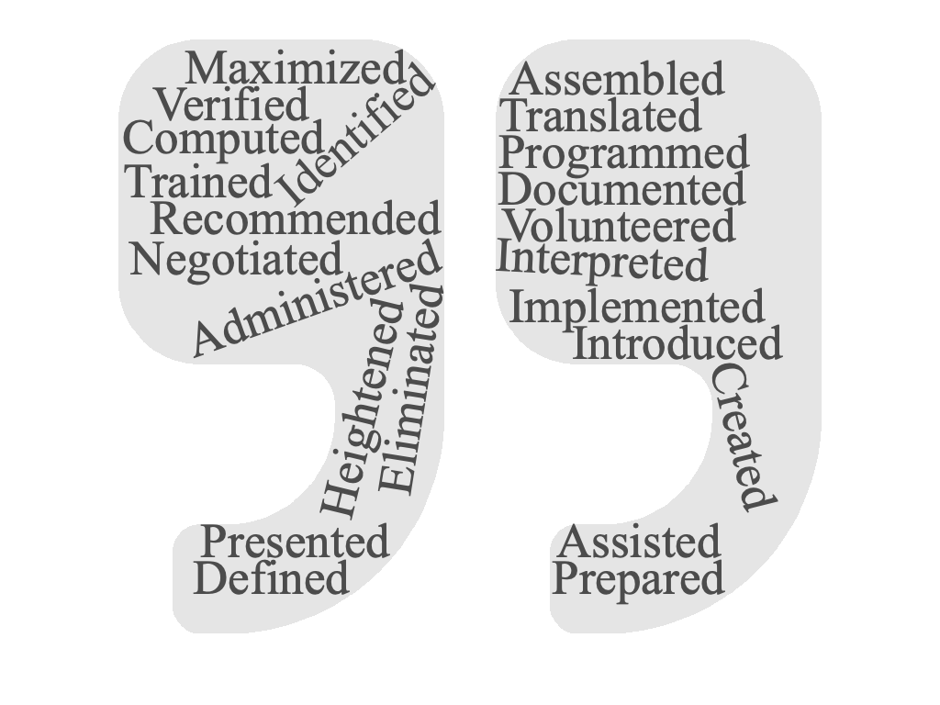
Action Verbs
Visit owl.purdue.edu for more action verbs!
Notes:
Key Concept: The facilitator should remind the tutors that if the students are having trouble thinking of words, there is an action verb list on OWL they can use to look up different verbs for the job descriptions.
https://owl.purdue.edu/owl/job_search_writing/preparing_an_application/action_verbs_to_describe_skills_jobs_and_accomplishments_in_employment_documents/action_verbs_list.html

Slide 16
Activities, Honors, Volunteer Experience
Purdue Equestrian Team Women in Business
Beta Gamma Sigma Honor Society Alpha Lambda Delta Phi Eta Sigma
Boiler Gold Rush Team Leader School of Management Peer Mentor
Notes:
Key Concept: The facilitator should stress that the rest of the student’s resume should be set up however the student wants. The tutor can guide the student by suggesting sections that may be helpful for the job in which the student is applying. Additional activities, clubs, awards, volunteer experience, can also be helpful if there is extra white space. The additional sections can be set up as shown or also more like the work experience section.

Slide 17
Extra Tips
Ultimate goal is to get an interview
White space
Employer will only take 15 seconds to glance at a resume
Don’t take over the tutorial
Be positive!
Notes:
Key Concepts: The facilitator should be sure to stress to the student that the ultimate goal of a resume is to get an interview. A lot of times, students will try to cram too much on a resume. One way to get the student to understand the importance of keeping to the point is to remind the student that having too much information will take away from the rest of the resume.
Another way to get different sections of the resume to stand out is to allow enough white space between each section. If the resume is too crammed together, many employers won’t take the time to read it.
Tutors should also not try to take over the tutorial. If a student doesn’t want help with a part that a tutor thinks needs tweaking, the tutor should refrain from interfering.
Students may seem down about some of their work experiences or lack of work experiences. Sometimes, tutors just need to encourage them and help them realize that they have valuable skills even if they don’t think they do.
Activity: The facilitator can pass around example resumes or the students can trade their own resumes. The facilitator should not allow the students to look at the resumes until instructed. When the facilitator says, the students can look at the resume for just 10 seconds. After looking at the resume, they should write down what they remember and share with the rest of the group.

Slide 18
The End

