Slide 1
Teaching and Assessing Grammar In The Writing Classroom

Slide 2
Presentation Overview
Assessing Grammar Effectively
This presentation will cover:
Ways to address grammar in the writing classroom.
Methods of marking grammatical errors in student papers.
Grammar resources for students outside the classroom.

Slide 3
What is a Problem Statement?
Students and Grammar
Students’ relationship with grammar is often an antagonistic one. They may believe that…
Grammar isn’t as important as expression.
If they’re bad at grammar, then they’re bad writers.
Writing is only a matter of grammar.

Slide 4
Formal Problem Statements
Grammar in the Classroom
However…
Grammar mistakes can distract the reader from their ideas/expression.
Grammar affects a writer’s ethos:
  Did the writer seem educated?
  Did they appear to take the work seriously?
  Tools like spell check aren’t always accurate.

Slide 5
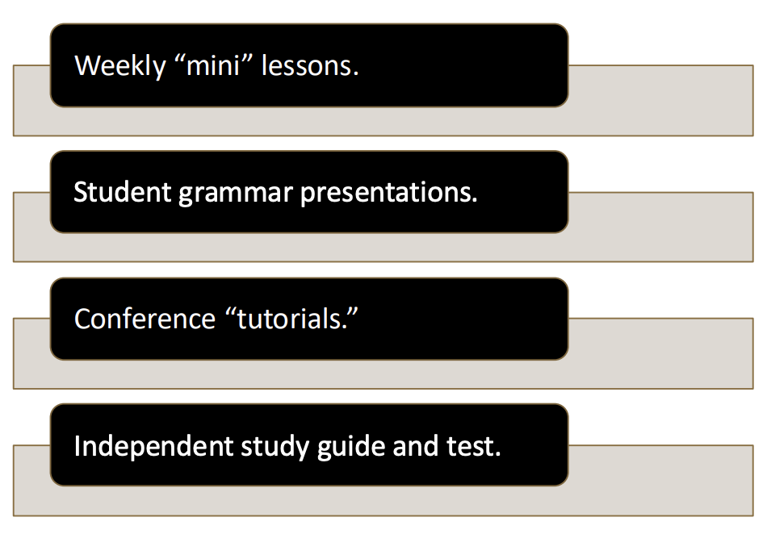
Grammar in the Classroom (cont.)
Methods of including grammar instruction:

Slide 6
Helping the Audience Understand Your Work
Weekly Mini-Lessons
If your strength is lecture:
Choose a common error you’ve noticed in students’ papers that week.
Illustrate the error in context.
  Bring photocopies of a paper excerpt.
  Work on an overhead copy.
Offer methods of recognizing the error.
Have students work in pairs on a sample text.

Slide 7
Weekly Mini-Lessons (cont.)
What to keep in mind with this approach:
Inform students early on that their papers will be used as sample texts.
Don’t identify the writers of sample papers.
Nobody wants to be the “bad example.”
Give students a chance to identify/fix the error before you give it away.
Let students do the work

Slide 8
Student Grammar Presentation
If you’re a fan of group work:
Have students pair up and draw grammar topic from a hat.
On their scheduled day, each pair will:
  Give a 10 -minute presentation.
  Create an accompanying handout for the class.
Encourage students to make presentations fun (quiz shows with prizes, Kahoot!, etc.)

Slide 9
Student Grammar Presentations (cont.)
What to keep in mind with this approach:
Point students to resources like the OWL or a writing handbook.
Make sure students understand the grammatical jargon they encounter/use. Will their audience understand it?
Meet with pairs during conferences to preview their presentations.

Slide 10
Student Grammar Presentations (cont. 2)
If you need to use conference time:
Address grammar one -on-one in context.
Using the student’s recent writing:
  Focus on one pattern of error at a time
  Have the student identify and correct the errors in his/her own paper
  Model revision techniques/alternatives

Slide 11
Student Grammar Presentations (cont. 3)
What to keep in mind with this approach:
Don’t overwhelm the student. Focus on only one or two errors per conference.
Give students a mini -assignment or goal for next time:
  Example: Eliminate comma splices in your next paper.
  Example: Be able to summarize the rules for semi-colon use.

Slide 12
Independent Study Guide
-
If you’re a proponent of individual study:
Hand out a packet of grammar study materials at the beginning of the semester.
Use a sample text each week to illustrate a grammar rule from the packet.
Hold a class review session.
Schedule a test or quizzes over the materials.

Slide 13
Independent Study Guide (cont.)
What to keep in mind with this approach:
Give students opportunities to see the grammar rules and concepts in context.
Review rules and concepts in conferences.
Have students work on sample texts in class.

Slide 14
Making Grammatical Errors
When you’re grading papers:
Focus on a pattern of error.
Correct only the first instance of an error.
Place a check mark in the margin beside the line where the error occurs.
Discuss patterns during conferences.
Resist the urge to edit —let the student do the work!

Slide 15

Proofreading Strategies
Discuss proofreading strategies in class and encourage students to:
Read their papers out loud.
Have a friend or roommate read it out loud while they look on.

Slide 16
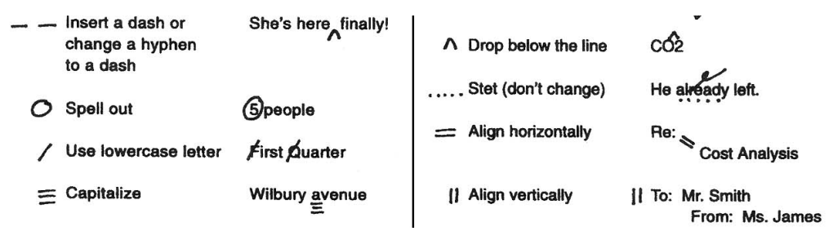
Proofreading Strategies (cont.)
3. Read backwards (from last sentence to first) in order to focus the brain on sentence -level error.
4. Print a paper copy and edit by hand. Give students a handout of editorial symbols to help them.

Slide 17
Grading Follow-Up
Tips:
Encourage students to review and work on their errors.
Discuss errors during conferences.
Have each student review and summarize comments on their paper.
How will they recognize and correct this error from now on?

Slide 18
Thank You
Purdue OWL
Krach Leadership Center
Web: https://owl.purdue.edu/
Phone: (765) 494-3723
Email: writing.lab@purdue.edu

