Slide 1
Invention (Prewriting)
Notes:
Rationale: Welcome to the “invention” slide presentation. This presentation is designed to introduce your students to the general concepts of invention, or prewriting, and to outline some invention strategies. The slides presented here are designed to aid the facilitator in an interactive presentation on the basics of invention. This presentation is useful for the beginning of a composition course and/or for the beginning of a writing project.
This presentation may be supplemented by OWL resources.
Directions: Each slide is activated by a single mouse click.
Suggested warm-up activity: Prior to the presentation, the facilitator might conduct a brief discussion about students’ experiences with prewriting and the steps they usually take when they compose. The facilitator may outline on a board some popular elements of the invention, or prewriting, process: generating ideas, research and investigation, analysis, etc. Some good questions to consider are the following: 1) how did you generate ideas for past projects? 2) what sort of questions did you ask? 3) did you conduct research before you formed your thesis? 4) how did the project turn out? 5) if you had the project to do over again, how might you change your prewriting process?
Writer and Designer: Elena Lawrick and Allen Brizee, 2007;
Design Contributor and Revising Author: Veronika Maliborska, 2014; Garrett Iván Colón, 2023
Developed with resources courtesy of the Purdue University Writing Lab
© Copyright Purdue University, 2007

Slide 2
Introduction
This presentation will help you with Invention and Invention Strategies.
Invention consists of two steps:
Plan your writing process
Explore your rhetorical situation:
Purpose
Audience
Genre (e.g. academic, professional)
Type of research you need to conduct
Notes:
Directions: Each slide is activated by a single mouse click.
Begin writing projects by developing a plan to address the three stages of writing: invention, composition, revision (see the “Writing Process” presentation for details). Begin projects as soon as you receive the assignment so there is plenty of time to conduct the necessary research. Begin process by exploring the rhetorical situation: purpose, audience, genre, research requirements.
For more information on invention and prewriting, please reference the “Prewriting (Invention)”, “Starting the Writing Process,” and “Writer’s Block / Writer’s Anxiety” resources on the Purdue OWL.

Slide 3
Invention Strategies
Ask critical questions:
Classical topics, stasis questions, tagmemics.
Map and cluster:
Invent and organize
ideas visually to explore relationships & processes.
Freewrite and brainstorm:
Record ideas without revising or proofreading.
Keep a journal:
Write personal explorations or reflections on ideas.
Notes:
Directions: Each slide is activated by a single mouse click.
Once you have generated information about your rhetorical situation, you may begin focusing your work and inventing, or prewriting. There are many approaches to invention. In general, we can organize these approaches into four categories: asking critical questions, freewriting and brainstorming, mapping and clustering, and keeping a journal.
Stasis questions: link to Purdue OWL page https://owl.english.purdue.edu/owl/owlprint/736/

Slide 4
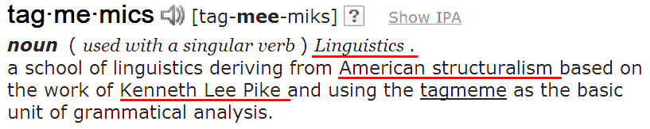
Ask Critical Questions: Classical Topics
Compare and contrast:
What is _____ similar to?
What is _____ different from?
Definition:
Dictionary definition of _____?
What group of things does this _____ belong to?
What are some concrete examples of the _____?
http://dictionary.reference.com/
Notes:
Directions: Each slide is activated by a single mouse click.
Asking critical questions to develop a topic is an ancient invention strategy first recorded in Western rhetoric by the Greeks and Romans thousands of years ago. Aristotle wrote about the classical topics, while Cicero and Quintilian wrote about the classical topics and the stasis questions. Tagmemics are a contemporary invention strategy developed by Kenneth and Evelyn Pike, Richard Young, and Alton Becker in the 1960s and 1970s.
Defining the topic or elements of the topic Is a good way to begin exploring commonly held beliefs about the topic. For example, how a society defines “murder” says something about its values. In addition, developing definitions allows authors to begin establishing categories to help explain complex issues or terms to audiences. Definition may play an important part of an essay (defining key terms), or it may serve as an entire essay. Please see the “Writing Definitions” and “Essay Writing” resources on the Purdue OWL for more information on definitions.
Asking questions that compare and contrast helps authors think about similarities and differences between topics or elements of topics. Similar to developing definitions, compare/contrast can form part of an essay, or it can act as the structure for an entire essay.
Dictionary entry for tagmemics is a screen-shot from http://dictionary.reference.com/

Slide 5
Ask Critical Questions: Classical Topics
Relationship:
Testimony:
What have I heard people say about _____?
What are some facts and stats about _____?
Cause
Effect
Purpose
What else is missing?
Notes:
Directions: Each slide is activated by a single mouse click.
Asking questions about the relationships between a topic and its causes and effects helps authors consider broader elements of the issue.
Examining the testimony, or what we consider credible evidence, allows authors to think critically about commonly held beliefs and facts involved with the topic. Discussing testimony also allows facilitators to begin a discussion about research. Some critical questions to ask include the following: how do we know what people say is the truth? What criteria should we use when researching to ensure credibility? How do we know something is a fact? Please see the OWL resources in the Research and Citation and the Internet Literacy sections of the site for more material on conducting critical, accurate research.

Slide 6
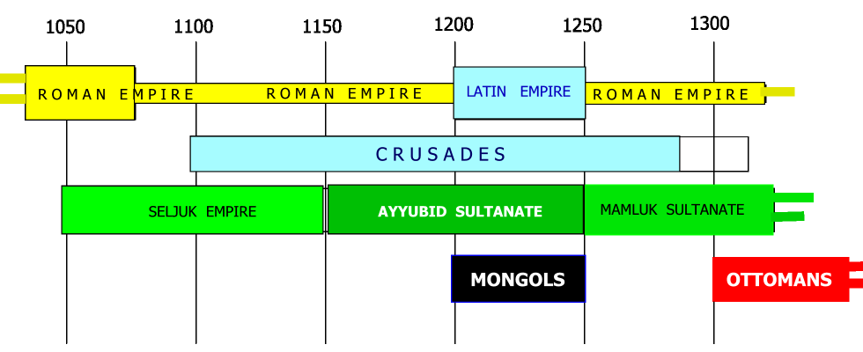
Asking Critical Questions: Classical Topics
Circumstances:
Is _____ possible/impossible?
What makes _____ possible/ impossible?
When did _____ happen?
What would prevent _____ from happening?
Circumstances
Main topic
Notes:
Directions: Each slide is activated by a single mouse click.
Considering the circumstances surrounding an issue allows authors to broaden research to think about elements that may impact the topic. This process is especially valuable when authors are attempting solve problems with their writing.
Building a timeline of circumstances can help visualize the topic.
Image licensed under Creative Commons: http://ts1.mm.bing.net/th?pid=8.1&id=HN.607999393104072413

Slide 7
Ask Critical Questions: Stasis Topics
Fact:
Is there an issue?
How did it begin and what are its causes?
What changed to create the issue?
Who is involved?
Definition:
What exactly is the issue?
What is it not?
What kind of an issue is it?
Notes:
Directions: Each slide is activated by a single mouse click.
The stasis questions are a process of invention that helps authors investigate topics to find common ground (with other authors) and solve problems. The exploratory nature of the stasis questions helps authors as they try to develop a deeper understanding of the issue. Facilitators can also use the stasis questions in group work to foster negotiation and collaboration between students to determine the facts of the topic, the definition of the topic, the quality (importance) of the topic, and the best policy for addressing the topic. Defining an issue (like definition in the classic topics above) is an essential part of invention for the stasis questions. This is especially important for problem-solution projects to help authors focus their work and communicate the scope of the project to audiences.

Slide 8
Ask Critical Questions: Stasis Topics
Quality:
How serious is the issue?
What are the costs of the issue?
Policy:
Who should address this issue?
Review Policies
Propose Change
Determine Priority
Evaluate Alternatives
Notes:
Directions: Each slide is activated by a single mouse click.
Determining the quality (or importance) of a topic is important because readers want to know why the issue demands their attention (why should I keep reading? How does this impact me? How does this impact other stakeholders?). Determining the importance of a topic is also important for problem-solution projects because readers may need to know what kind of resources should be allocated to tackle the problem.
Figuring out policy, or what to do, regarding a topic is often the first step authors jump to after they pick an issue. However, unless authors ask - and answer - the types of critical questions outlined in this presentation, they rarely have enough information on the topic to offer sound, well-researched solutions. Important to remember is that invention (like the writing process) is recursive, and authors visit and revisit this final step in the stasis questions as they move through their research. Solutions may change, or be eliminated altogether, as authors generate data and discover more information on their topic.

Slide 9
Ask Critical Questions: Tagmemics
Contrastive Features:
How is _____ different from things similar to it?
How has it been different for me?
Variation:
How much can _____ change and still be itself?
How is _____ changing?
What are the different varieties of _____?
Notes:
Directions: Each slide is activated by a single mouse click.
Like the stasis questions, tagmemics help authors develop a deeper understanding of a topic to work toward collaboration and problem solving between parties that may not share the same point of view. The tagmemic questions are influenced by contemporary linguistic theory (Pike) and cognitive psychology (Carl Rogers). Considering the contrastive features of a topic or element of a topic helps authors develop more information about the issue and explore what they know about the issue before moving beyond, or outside, the issue. Exploring the variations of the topic helps authors move outside the issue to develop a broader understanding of how the topic impacts or is impacted by other issues.

Slide 10
Ask Critical Questions: Tagmemics
Distribution:
Where and when does _____ take place?
What is the larger thing of which _____ is a part?
What is the function of _____ in this larger thing?
Distribution:
Describe it (colors, shapes, etc.)
Compare it (what is it similar to?)
Associate it (makes you think of?)
Analyze it (how is it made?)
Apply it (uses)
Argue for or against it
Notes:
Directions: Each slide is activated by a single mouse click.
Exploring the distribution of a topic allows authors to consider different categories the issue may influence. Moreover, considering the distribution helps authors to think about how these different categories impact the topic and how the topic may work within these outside categories.
Cubing helps authors consider a subject from six different points of view. Like many of the questions above, this process moves authors from a deeper understanding of the topic to a broader understanding of issues surrounding the topic and how it interacts and/or impacts these issues.

Slide 11
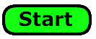
Freewriting
Write paragraphs; sentences do not have to be finished
Look at the topic and think about it briefly.
Set your timer to 5 minutes
Ready? Set?
Don't stop! Don’t edit!
When time is up, you can finally look over your ideas.
Notes:
Directions: Each slide is activated by a single mouse click.
Freewriting and brainstorming allow authors to generate ideas free from grammar and mechanics rules and rules of organization that may hinder discover and creativity.
Spontaneity in writing can be just as important as the detailed critical analysis fostered by the questions outlined above. Freewriting allows authors to focus on the present and react quickly to ideas as they emerge. Some of the material generated in freewriting may not apply to the writing assignment, but many exciting ideas can be harnessed from freewriting when the rules of grammar, mechanics and organization are relaxed. Freewriting can also be a therapeutic outlet for pent-up frustrations that accumulate in our minds as we tackle challenging writing projects.

Slide 12
Brainstorming
Note key words or phrases in list form under your subject
Look at the topic and think about it.
Set your timer to 5 minutes
Ready? Set?
Keep your list going the entire time.
When time is up, you can finally look over your ideas.
Notes:
Directions: Each slide is activated by a single mouse click.
Brainstorming is a little more organized than freewriting. When authors brainstorm, they limit their thoughts to a list of key words or short phrases related to the topic. Rather than recording anything and everything in a freewriting session, to brainstorm, authors think and write about the key words or short phrases involving the issue. Similar to freewriting, however, is the process of writing rapidly while ignoring the rules of grammar and mechanics.

Slide 13
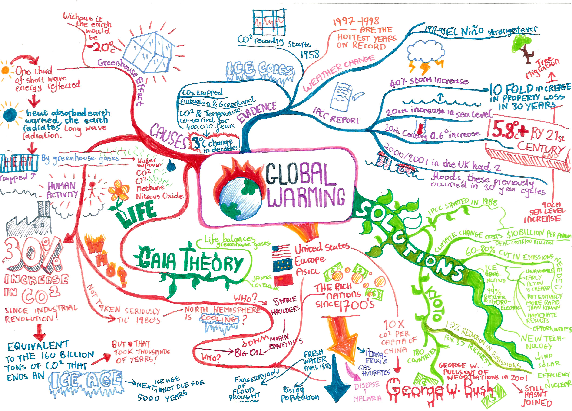
Map and Cluster
Start with a central word; as related concepts pop in your head, indicate them as branches, arrows, bubbles, etc.
Notes:
Directions: Each slide is activated by a single mouse click.
Brainstorming is a little more organized than freewriting. When authors brainstorm, they limit their thoughts to a list of key words or short phrases related to the topic. Rather than recording anything and everything in a freewriting session, to brainstorm, authors think and write about the key words or short phrases involving the issue. Similar to freewriting, however, is the process of writing rapidly while ignoring the rules of grammar and mechanics.
Image licensed under Creative Commons: http://ts1.mm.bing.net/th?pid=8.1&id=HN.607999805423550788

Slide 14
Keep a Personal Journal
Personal reflection:
Why is this important to me?
How does it relate to me?
How do I feel about it?
How did I feel about this in the past?
How might my connection to this change in the future?
Notes:
Directions: Each slide is activated by a single mouse click.
Keeping a journal is an effective invention strategy for recording personal reflection on a topic and exploring issues in a relaxed atmosphere. Journals allow authors to hold conversations with themselves. Authors may also hold imaginary conversations with other people (students could even write their instructor an angry letter about the assignment!). Lastly, journals should act as a rules-free atmosphere that fosters freedom and creativity. Authors can paste cut-outs and draw pictures using pencils, pens, or even crayons. Be honest in your journal, but keep it in a safe place.

Slide 15
Keep a Personal Journal
Storytelling (create a story about your topic)
How do the characters deal with the situation?
Why do they react the way they do?
How does the story end, and how does it reflect how you want the real life situation to end?
What would you have to do to bring about this change?
Notes:
Directions: Each slide is activated by a single mouse click.
Journals also allow authors the freedom to write creatively about their project. Often times, students get bogged down with the research and analysis involved in writing assignments. Writing a story about the assignment can help authors think about larger concerns and refocus on what they would like to see happen at the end of their work. Writing creatively about a problem can help authors think less about what needs to be done now to accomplish goals and more about the end results. Writing creatively also allows authors to think more about relationships of those involved (stakeholders) and how they might feel and react to the issue.

Slide 16
Recap: Invention Strategies
Ask critical questions:
Classical topics, stasis questions, tagmemics.
Map and cluster:
Invent and organize
ideas visually to explore relationships & processes.
Freewrite and brainstorm:
Record ideas without revising or proofreading.
Keep a journal:
Write personal explorations or reflections on ideas.
Notes:
Directions: Each slide is activated by a single mouse click.
Once you have generated information about your rhetorical situation, you may begin focusing your work and inventing, or prewriting. There are many approaches to invention. In general, we can organize these approaches into four categories: asking critical questions, freewriting and brainstorming, mapping and clustering, and keeping a journal.

Slide 17
Thank You
Purdue University On-Campus Writing Lab
Krach Leadership Center (2nd Floor)
Web: http://owl.english.purdue.edu/
Phone: (765) 494-3723
Email: owl@owl.english.purdue.edu
Notes:
Purdue students in West Lafayette, IN may visit the On-Campus Writing Lab in Krach Leadership Center, 2nd Floor. Worldwide users may call the grammar hotline with short questions. Worldwide users may also visit the Purdue OWL to access a large library of writing resources.

