Slide 1
EFFECTIVE PERSUASION
Developing Persuasive Documents
7/24/25
Notes:
Rationale: Welcome to “Effective Persuasion: Developing Persuasive Documents.” This presentation is designed to introduce your students to a variety of factors that contribute to strong, effective, and ethical persuasion in their writing. The eighteen slides presented here are designed to aid the facilitator in an interactive presentation of the elements of persuasive writing and include examples and questions. This presentation is ideal for any course in which students will be required to write a persuasive document.
This presentation may be supplemented with an OWL handout, “Using Rhetorical Strategies for Persuasion” (Rhetorical Strategies - Purdue OWL® - Purdue University)
Directions: Each slide is activated by a single mouse click
Writer and Designer: Dana Bisignani, 2007
Contributors: Muriel Harris, Karen Bishop, Bryan Kopp, Matthew Mooney, David Neyhart, and Andrew Kunka
Design Contributor and Revising Author: Veronika Maliborska, 2014; Garrett Iván Colón, 2023; Shruti Subramaniyan, 2025
Developed with resources courtesy of the Purdue University Writing Lab
Grant funding courtesy of the Multimedia Instructional Development Center at Purdue University
© Copyright Purdue University, 2000, 2006

Slide 2

Overview
This presentation will cover:
The persuasive context
The role of the audience
Research and citations
The establishment of credibility
Notes:
The following slides will cover the following topics. We’ll start by discussing the persuasive context and then focus primarily on the role of the audience in the development of a persuasive document. Next, we’ll discuss how to effectively research your topic and various ways to establish your credibility.
Image source: www.flickr.com licensed under creative commons.

Slide 3
What is Persuasive Writing?
Persuasive writing seeks to convince its readers to embrace the point-of-view presented by appealing to the audience’s reason and understanding through argument and/or entreaty.
Notes:
First, let’s establish what we mean by persuasive writing.

Slide 4

Persuasive Genres
You encounter persuasion every day:
TV Commercials
Letters to the Editor
Junk mail
Magazine ads
College brochures
Can you think of other persuasive contexts?
Notes:
You encounter persuasion every day in many forms. Have you recently been persuaded by something? Have you been on a web site and been tempted to click on an advertisement or article? What drew you in?
Image source: www.commons.Wikimedia.org licensed under creative commons.

Slide 5
Steps for Effective Persuasion
Understand your audience.
Find common ground with your audience.
Support your opinion.
Know the various sides of your issue.
Respectfully address other points of view.
Establish your credibility.
Notes:
In order to create an effective persuasive document, you should consider these important steps. We’ll go over how to accomplish each of these. Let’s start with audience.

Slide 6
When to Persuade an Audience
Your organization needs funding for a project.
Your boss wants you to make recommendations for a course of action.
You need to shift someone’s current point of view to build common ground so action can be taken.
Notes:
Here are some circumstances you might encounter in which you would need to persuade someone. Have you ever needed to persuade someone? What did you persuade your audience to do? Were you successful?

Slide 7
Understanding Your Audience
Who is your audience?
What beliefs do they hold about the topic?
What disagreements might arise between you and your audience?
How can you refute counterarguments with respect?
Notes:
Here are some questions you should ask yourself at the start of any persuasive writing project.
It’s important to know something about what your audience believes. For example, you might use different tactics to persuade an audience who knows little about a topic versus an audience who already has strong beliefs on a topic. If you understand where your audience is coming from, you can predict how they might react and what kinds of arguments they might find convincing.

Slide 8
Understanding Your Audience
What concerns does your audience face?
For example:
Do they have limited funds to distribute?
Do they feel the topic directly affects them?
How much time do they have to consider your document?
Notes:
Here are some more questions you might ask yourself about your audience. You might also think of other questions, depending on the specific nature of your project.

Slide 9
Understanding Your Audience
Help your audience relate to your topic -
Appeal to their hearts as well as their minds
Use anecdotes when appropriate
Paint your topic with plenty of detail
Involve the reader’s senses in these sections
Notes:
It’s important to back up your argument with plenty of reputable sources and information. But people make decisions with their hearts as well as their minds. While you don’t want to become sentimental about your topic, you do want your audience to be able to relate to your topic and to feel connected to your concern. If they don’t care about the topic, why should they bother to change their minds?
Here are some ways you can get your audience more involved. People tend to feel more involved in issues that are local or that directly affect them. For example, if you’re trying to persuade your town to give more funding to local programs for the homeless, paint an accurate but detailed picture of what someone who’s homeless might go through in one day, or discuss in detail the current lack of resources that are available in your area.

Slide 10
Researching an Issue
Become familiar with all sides of an issue.
You can try to:
Find common ground.
Understand the history of the topic.
Predict counterarguments your audience might make.
Find strong support for your own perspective.
Notes:
We’ve already discussed why it’s important to find some common ground, and you need to research both sides of a topic to be able to do so. Often, it’s tempting to only research the side of the topic for which we’re arguing. However, if you’re going to be persuasive and sound educated about the topic, you’ll need to be able to address the opposing viewpoint as well. Also, when writing a persuasive essay, you’ll often need to include a counterargument. This is the section in which you can acknowledge and then refute major arguments made by the opposing viewpoint. Being able to predict what arguments a reader might make against you will give the opportunity to disarm these readers ahead of time. This is why it’s so important to think about your audience before you start writing.

Slide 11
Researching an Issue
Find common ground with your audience.
For example:
  Point of Opposition: You might support a war, whereas your audience might not.
  Common ground: Both sides want to see their troops come home.
Notes:
The most effective persuaders know how to find common ground and let their audience know that they understand where they’re coming from. This is especially true if the topic is controversial and/or your audience has strong opinions about it already. Here’s one example of common ground that you might find for such a topic. The best way to find that common ground is to research both sides of the issue at hand.

Slide 12
Researching an Issue
Predict counterarguments.
For example:
  Your Argument: Organic produce from local Farmers’ Markets is better than store-bought produce.
  The Opposition: Organic produce is too expensive.
Notes:
If you know how the opposition might react to your argument, you’ll be better equipped to disarm their arguments by creating a strong counterargument. Here’s one example of how the opposition might react. Can you think of a good counterargument off the tops of your heads?

Slide 13
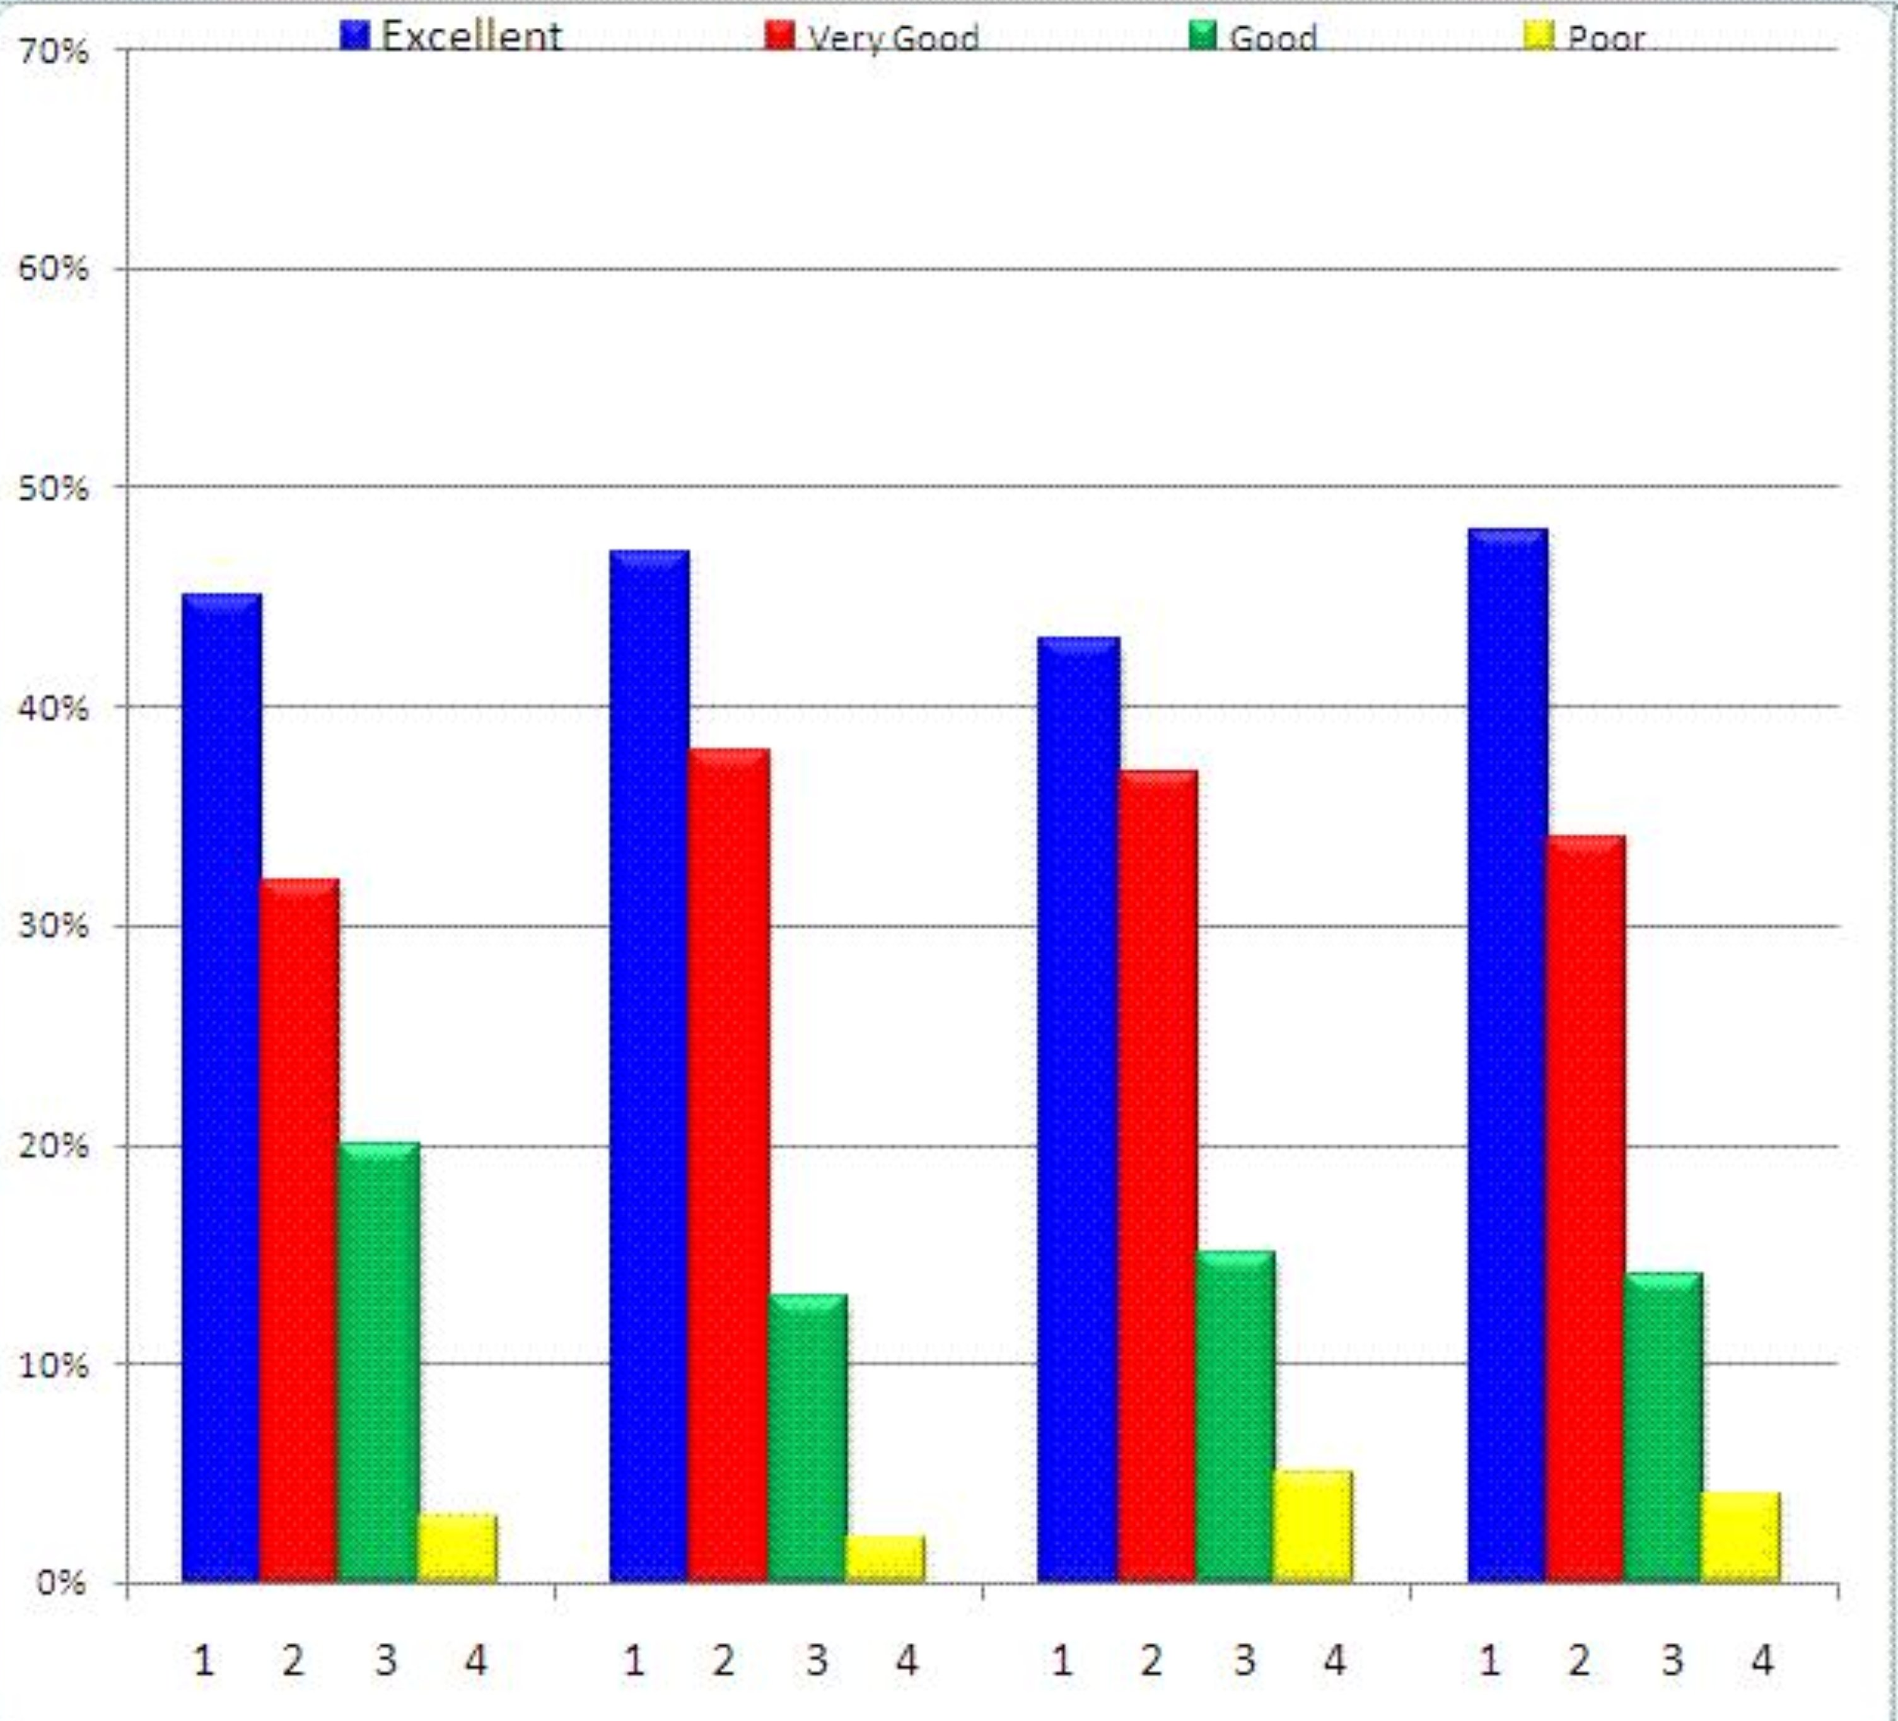
Supporting Your Perspective
Appeal to the audience’s reason:
Use statistics and reputable studies.
Cite experts on the topic:
Do they back up what you say?
Do they refute the other side?
Notes:
Hard evidence is always more convincing than simply stating your opinion. Anyone can disagree with your opinion, but if you have statistics to back up your opinion, your argument will be harder to simply dismiss as personal opinion. When it’s clear to your audience that you know what you’re writing and speaking about, this will help establish your credibility.

Slide 14
Cite Sources with Some Clout
Which source would a reader find more credible?
The New York Times
http://www.myopinion.com
Which person would a reader be more likely to believe?
Joe Smith from Fort Wayne, IN.
Dr. Susan Worth, Prof. of Criminology at Purdue University.
Notes:
Let’s say you’re doing a persuasive paper on crime, and you want to convince your audience that crime rates are down. Which source has more clout? If you were going to cite an expert to back up your argument, which person would be more convincing for your readers? Joe Smith, who was interviewed by the local paper? Or Dr. Susan Worth, who has recently published a study on the rate of violent crime in the United States?

Slide 15
Establish Credibility
Cite credible sources
Cite sources correctly and thoroughly.
Use professional language (and design).
Edit out all errors.
Example of a Correctly Cited Source in the References Section
Cummings, J. N., Butler, B., & Kraut, R. (2002). The quality of online social relationships. Communications of the ACM, 45(7), 103-108
Notes:
The credibility of your sources and the amount of support you have to back up your claim will do much to persuade your audience and establish your credibility. Remember too that even if your ideas are well-supported, errors like incorrect grammar or poor organization can also hurt your credibility, which is why it’s so important to not only do your research and get your ideas down, but to revise your writing as well. Polished documents are taken more seriously by an audience. The more credible your audience perceives you to be, the better chance you have of them taking your viewpoint seriously.
Sample references are in APA style. Source:
APA Sample Paper - Purdue OWL® - Purdue University

Slide 16
Cite Sources Ethically
Don’t misrepresent a quote or leave out important information.
  Misquote: “Crime rates were down by 2025,” according to Dr. Smith.
  Actual quote: “Crime rates were down by 2025, but steadily began climbing again a year later,” said Dr. Smith.
Notes:
It might be tempting to use only certain parts of information to support your argument, especially if you’re having a hard time finding sources to support your stance on a topic. Doing so, however, is unethical. You are not presenting accurate information to your audience, and if your reader decides to further read your cited source, you will quickly lose credibility when they discover your dishonesty.

Slide 17

Tactics to Avoid
Don’t lecture or talk down to your audience.
Don’t make threats or “bully” your reader.
Don’t employ guilt trips.
Be careful if using the second person, “you.”
Notes:
Don’t speak or write to your audience as if they don’t know anything, especially if you’re writing for an audience that does have knowledge about the topic already. It’s insulting. People are more willing to listen if you address them as equals.
Has anyone ever sent you on a guilt trip about something? How did it feel? It’s not a very effective tool for getting people on board either.
Last, people sometimes use the second person “you” when they are trying to get the audience to relate to a topic; however, this can sometimes be perceived as accusation. For example, let’s say you’re writing about the environment. You write, “With every soda can you throw away, you make a landfill bigger.” Your audience will probably resist this because they may feel as if you’re accusing them of being the problem. Try rewriting it in a more neutral way: “Aluminum cans can easily be recycled rather than taking up room in landfills.” Don’t put your audience on the defensive. If they’re mad, they won’t listen to what you’re saying.
Image source: www.flickr.com licensed under creative commons.

Slide 18
Thank You
Purdue University On-Campus Writing Lab
Krach Leadership Center (2nd Floor)
Web: http://owl.english.purdue.edu/
Phone: (765) 494-3723
Email: writing.lab@purdue.edu@purdue.edu
Notes:
Purdue students in West Lafayette, IN may visit the On-Campus Writing Lab in Krach Leadership Center, 2nd Floor. Worldwide users may also visit the Purdue OWL to access a large library of writing resources.

