Slide 1
The Chicago manual of style (17th edition)
Notes & Bibliography Formatting and Style Guide
Notes:
Welcome to “Chicago’s Notes and Bibliography Formatting and Style Guide.” This PowerPoint presentation is designed to introduce your students to the basics of Chicago’s notes and bibliography formatting and style. You might want to supplement the presentation with more detailed information posted on the Purdue OWL: https://owl.purdue.edu/owl/research_and_citation/chicago_manual_17th_edition/cmos_formatting_and_style_guide/chicago_manual_of_style_17th_edition.html.
Designer: Ethan Sproat
Based on slide designs from the OWL “APA Formatting and Style Guide” powerpoint by Jennifer Liethen Kunka and Elena Lawrick.
Revising Author: Ryan Schnurr, 2017; Garrett Iván Colón, 2023

Slide 2
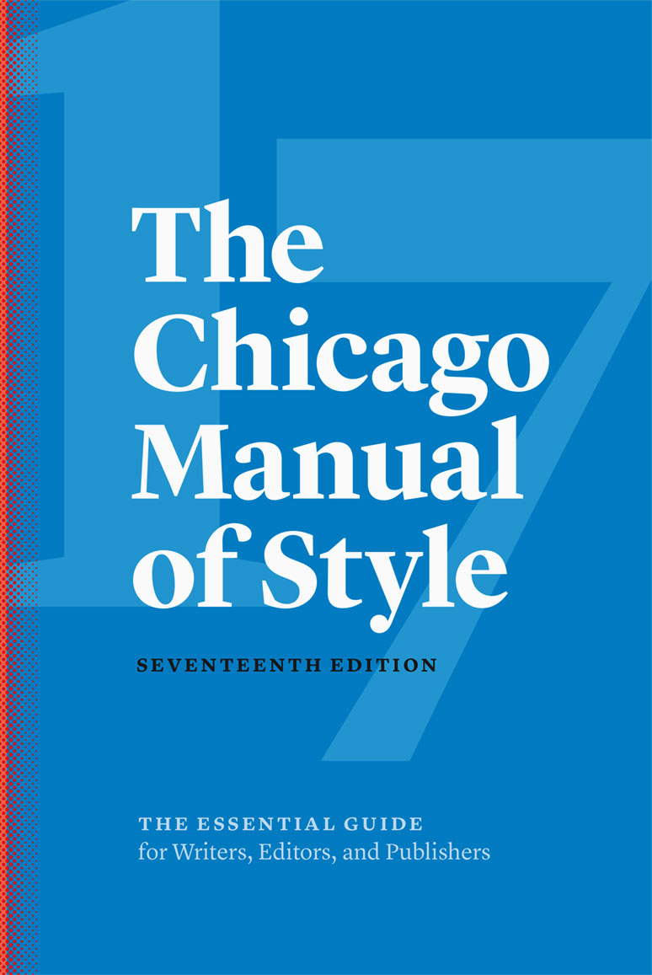
What is Chicago Style?
Chicago Style formatting for notes and bibliography is often used in the humanities, especially in history, literature, and the arts.
The University of Chicago also offers The Chicago Manual of Style Online, a website that provides additional resources: www.chicagomanualofstyle.org
Chicago regulates:
Stylistics and document format
in-text citations (notes)
End-of-text citations (bibliography)
Notes:
The Chicago Manual of Style, seventeenth edition, published by the University of Chicago Press, is a reference book that covers the publishing process, style and usage, and two systems of documentation: notes and bibliography and author-date references. It is geared toward publishing professionals and is the source of documentation guidelines in this presentation, which will focus on the notes and bibliography style documentation.
Chicago Style formatting is often used in the humanities, especially in literature, history, and the arts, and in some academic and trade publishing.
This slide also presents three basic areas regulated by Chicago that students need to be aware of—stylistics and document format, in-text citations (notes), and end-of-text citations (bibliography). The following slides provide detailed explanations regarding each area.

Slide 3
Chicago Style (con’t)
Kate L. Turabian’s A Manual for Writers of Research Papers, Theses, and Dissertations (9th ed.) offers more specific Chicago style information for students and researchers.
This presentation draws on the 9th edition of A Manual, as well as the most recent changes to the 17th edition CMOS.
Notes:
Kate L. Turabian’s A Manual for Writers of Research Papers, Theses, and Dissertations, ninth edition, presents Chicago style for students and researchers. It is the source for some specific guidelines in this presentation pertaining to students and teachers.
It should be noted that the previous (eighth) edition of Turabian’s work conforms to the 16th edition of the CMOS, not the current 17th edition.

Slide 4
Overview
This presentation will cover:
  How to format a paper in Chicago Style (17th ed.)
    General guidelines
    Title page
    Section headings
  In-text citations (author-date)
  Documenting sources (bibliography)
    Core elements
    Formatting best practices
Notes:
This PPT will cover the 17th edition of The Chicago Manual of Style: how to format a paper and manage source citations (known as “documentation” in previous issues of CMOS), both in-text and at the end of the document.

Slide 5
Significant Changes in 17th Ed.
The 17th edition CMOS updates and adds to the 16th edition. Here are some significant changes and additions:
  Techniques for achieving gender-neutral language (5.255-5.256)
  Italics are the preferred form of emphasis in a text; moreso than boldfaced or underscored text (7.51)
  Internet should now be styled as internet (7.80)
  E-mail should now be styled as email (7.89)
  Use of ibid. for repeated citations is discouraged in favor of shortened citations (14.34)
  Use of the 3-em dash for repeated names in a bibliography is discouraged for authors (14.67)
Notes:
This PowerPoint presentation reflects the most recent guidelines for paper formatting, in-text citations, and documentation, available in the 17th edition of The Chicago Manual of Style.
For a complete list of changes in the 17th edition, visit http://www.chicagomanualofstyle.org/help-tools/what-s-new.html

Slide 6
Caveat
Basic rule for any formatting style:
Always follow your instructor’s guidelines
Notes:
Many instructors who require their students to use Chicago formatting and citation style may have small exceptions, as may journals in the field. These instructor or journal-specific guidelines should always supersede the more general recommendations of the manual.

Slide 7
Formatting: General Guidelines
Chicago recommends:
  Typing on white, standard-sized paper (8.5“ x 11“)
  Using 1”-1.5” margins on all sides
  Using a readable typeface (e.g., Times New Roman) at no less than 10 pt. font (preferably 12 pt.)
  Double-spacing all text, with one space after punctuation between sentences
  Numbering pages beginning with Arabic numeral “1” on the first page of text
Notes:
This slide presents the general format of a Chicago-style paper:
The text should be typed and printed on standard-sized paper (8.5” x 11”), and should include consistent margins of no less than 1” and no greater than 1.5” on all sides.
Chicago recommends a “readable” font, such as Times New Roman or Palatino, and prefers that works be written in 12 pt. (although they will accept 10 pt.).
All text in the paper is to be double-spaced with the exception of the following items, which are to be single-spaced: block quotations, table titles and figure captions, footnotes or endnotes, and bibliography or reference list entries.
Only one space should follow end-of-sentence punctuation.
Page numbers should begin on the first page of text (not on the title page) and should be written in Arabic numerals beginning. Page numbers can be placed in one of three locations: flush right in the header, centered in the header, or centered in the footer.
Note that formatting requirements for theses and dissertations, in particular, may vary.

Slide 8
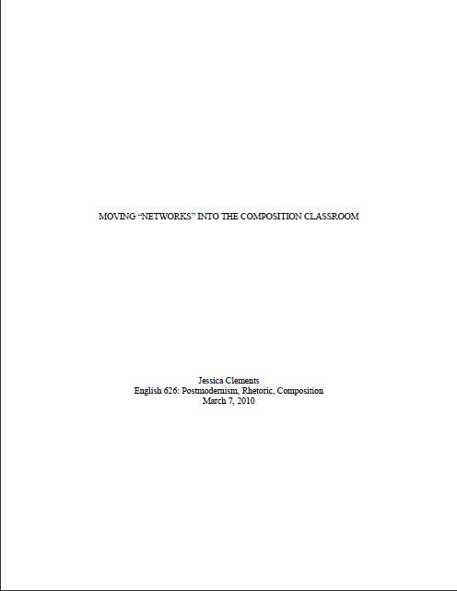
Formatting: Title Page
No page numbers
on title page
Title is centered one-third of the way down the page and written in ALL CAPS.
Name, course, and date follow several lines later, and are also centered.
Notes:
This slide visually presents Chicago format for a title page, which consists of two major sections: title and author information.
Titles should be centered one-third of the way down the page and written in all capital letters. When subtitles apply, end the title line with a colon and follow with the subtitle line (also written in all capital letters) on the following line.
Several lines later, students should include their name, full course information, and a complete “month-day-year” date, each on its own separate, single-spaced line. Instructors may require additional information.
It is also acceptable practice to place the title on the first page of text.
No headers or footers, including page numbers, are included on the title page.

Slide 9
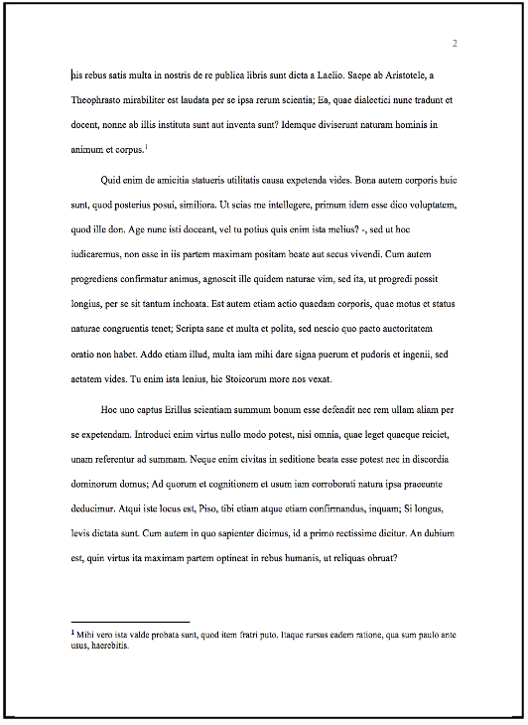
Formatting: Body Text
Body text should be double-spaced, with no break between paragraphs or sections.
Footnotes and endnotes are single-spaced.
Notes:
Page numbers begin on the first page of text, with Arabic numeral 1, either flush right in the header, centered in the header, or centered in the footer.
All text should be double-spaced, with no break between sections.
The following exceptions apply: single-spaced block quotations, table titles, and figure captions.
Footnotes and endnotes are single-spaced.
Sources used in the paper should be identified in footnotes and in the bibliography.

Slide 10
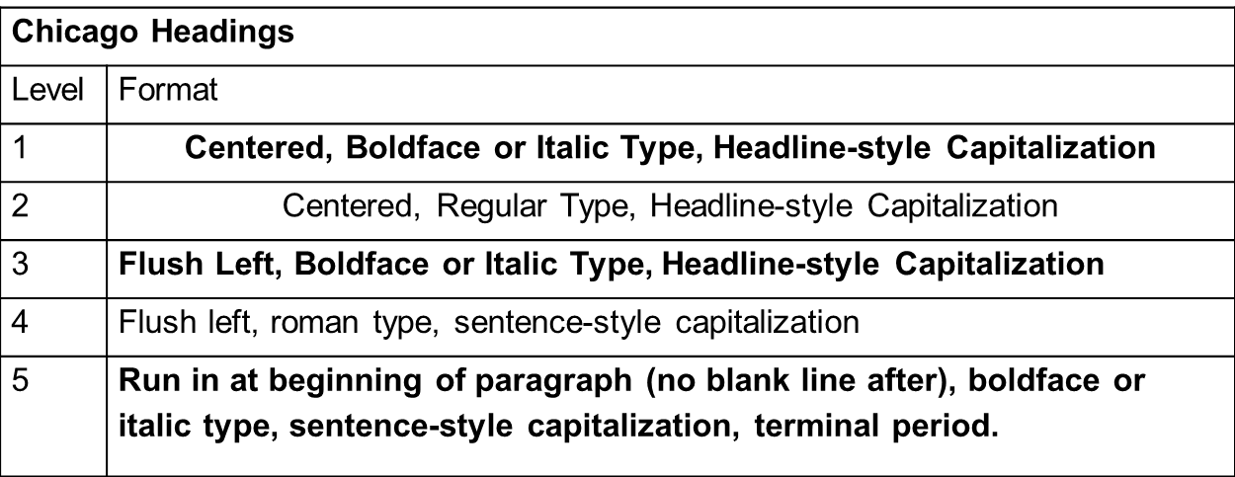
Formatting: Section Heading
Chicago has an optional system of five heading levels:
Notes:
Longer papers, such as research papers, may require the author to divide the paper into sections using subheadings. Chicago allows you to devise your own format but privileges consistency. Put an extra line space before and after subheads and avoid ending them with periods.

Slide 11
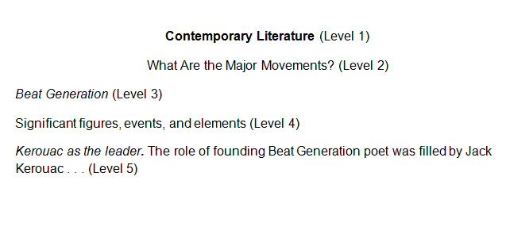
Formatting: Headings (con’t)
Here is an example of the five-level heading system:

Slide 12
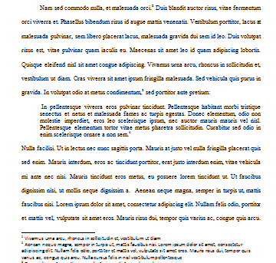
Formatting: Quotes
A prose quotation of five or more
lines should be “blocked.”
The block quotation is singled-
spaced and takes no quotation
marks, but you should leave an
extra line space immediately
before and after. Indent the entire
quotation .5” (the same as you
would the start of a new paragraph).
Block quotations may be preceded with a period rather than a colon.

Slide 13
Formatting: Tables and Figures
Position tables and figures after the paragraph in which they’re described.
Number tables and figures separately, in the order you mention them in the text.
In the text identify tables and figures by number.
Ex. “in figure 3” rather than by location (“below”).

Slide 14
Formatting: Tables and Figures (con’t)
Every table should have a number and a (short and descriptive) title, flush left on the line above it.
Table 1. Title without a terminal period
Every figure should have a number and a caption, flush left on the line below the figure.
Figure 2. Caption with or without a terminal period.
Any figure or table that uses symbols or patterns should be accompanied with a key to identify them, either within the figure or table itself or in its caption.

Slide 15
Formatting: Tables and Figures (con’t)
Cite the source of table and figure information with a “source line” at the bottom of the table or figure.
  Source lines are introduced by the word ‘Source(s),’ followed by a colon, and end with a period.
  Cite a source as you would for parenthetical citation, minus the parentheses, and include full information in an entry on your Bibliography page.
  Acknowledge reproduced or adapted sources appropriately (i.e., data adapted from ___ ).

Slide 16
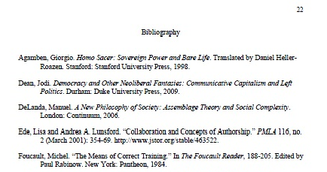
Formatting: Bibliography
Center the title, “Bibliography,” at the top of the page. Do not bold, italicize or enclose in quotation marks.
Flush left the first line of the entry and indent subsequent lines
Single-space reference entries internally. Double-space entries externally.
Order entries alphabetically by the authors’ last names.
Notes:
The first page of your back matter, your comprehensive list of sources cited, should be labeled “Bibliography.”
Leave two blank lines between the word “Bibliography” and your first entry. One blank line should be left between remaining entries, which should be listed in letter-by-letter alphabetical order according to the first word in each entry.
Sources you consulted but did not directly cite may or may not be included (consult your instructor).

Slide 17
Source Citations: The Basics
Authors are required to identify source material for direct quotations, paraphrases, and “any facts or opinions not generally known or easily checked” (14.1).
Notes-Bibliography Style:
Requires footnotes and/or endnotes to cite sources and/or provide relevant commentary within the text.
Includes each source cited within the text as an entry in the bibliography at the end of the paper.
Notes:
“Ethics, copyright laws, and courtesy to readers require authors to identify the sources of direct quotation or paraphrases and of any facts or opinions not generally known or easily checked” (The University of Chicago 2017, 14.1).
In other words, regulation of stylistics and document format, in-text citations, and end-of-text citations is important for avoiding plagiarism, building author credibility, and facilitating scholastic discourse—not necessarily in that order. Consistency and readability are of the utmost importance in this regard.
Chicago’s Notes and Bibliography style is recommended for those in the humanities and some social sciences. It requires using notes to cite sources and/or to provide relevant commentary. Each source that shows up in the text must have a corresponding entry in the references list at the end of the paper.

Slide 18
Source Citations: Bibliography
Invert authors’ names—last name followed by first name—and alphabetize reference list entries by the last name of the first author of each work.
Ex. Agamben, Giorgio
Use headline-style capitalization for titles.
Ex. A Tale of Two Cities
Italicize titles of longer works such as books and journals.
Put quotation marks around the titles of shorter works such as journal articles or essays in edited collections. Unpublished works are also placed in quotations.
Ex. A Tale of Two Cities vs. “An Essay on Dickens’ A Tale of Two Cities”
Publishers’ names are generally written out in full but may be abbreviated.
Ex. Purdue University Press OR Purdue UP
Notes:
This slide provides basic rules related to creating references entries.

Slide 19
Source Citations: Bibliography (con’t)
For multiple authors, use the conjunction “and,” not the ampersand (&) symbol.
For two to three authors or editors
  write out all names in the order they appear on the title page of the source in both your notes and bibliography.
For four to ten authors:
  -write out all names in the bibliography but use
  just the first author’s name and “et al.” in the
  notes.
Notes:
This slide provides basic rules related to creating references entries.

Slide 20
Source Citations: Bibliography (con’t)
When determining the appropriate formatting for a citation on the bibliography page:
Identify the source type (book; journal article; online article)
2. Find the appropriate citation on the Purdue OWL Chicago Guide: http://owl.english.purdue.edu/owl/resource/717/01/
3. “Mirror” the sample entry on your bibliography page, replacing the sample information with the new entry’s information
Notes:
This slide provides basic rules related to creating references entries.

Slide 21
Source Citations: Bibliography (con’t)
For electronic journal articles and other web sources, DOIs (Digital Object Identifiers) are preferred to URLs (Uniform resource Locators).
DOIs are to be prefaced with the letters “doi” and a colon. ex: DOI: 10.1353/art.0.0020
While DOIs are assigned to journal articles in any medium, you only need to include a DOI if you access the electronic version of the source.
If you must use a URL, look for the ‘stable’ version assigned by the journal.
Notes:
This slide provides basic rules related to creating references entries for electronic sources. An example of a bibliographic citation with a stable url is as follows:
Ede, Lisa and Andrea A. Lunsford. “Collaboration and Concepts of Authorship.” PMLA 116, no. 2 (March 2001): 354-69. http://www.jstor.org/stable/463522.

Slide 22
Source Citations: Bibliography (con’t)
No access date is required to be reported for electronic sources. Access dates cannot be verified; therefore, only resort to using access dates when the date of publication is unavailable.
If you cannot ascertain the publication date of a printed work, use the abbreviation “n.d.”

Slide 23
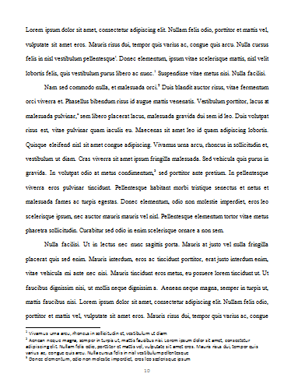
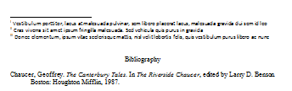
Source Citations: In-Text NB
In-Text Citations:
Each time a source is used in the text, it must be cited by note: footnote or endnote.
  Footnotes appear at the foot (bottom) of the page and are preferred.
  Endnotes appear at the end of the paper before the bibliography.
  (Endnotes are useful when footnotes have become exorbitant.)

Slide 24
Source Citations: In-Text NB (con’t)
In-Text Citations:
A combination of footnotes and endnotes and even author-date style can be used:
  Use footnotes for substantive commentary and cite sources with endnotes.
  Use footnotes for substantive commentary and cite sources with author-date parenthetical style.

Slide 25
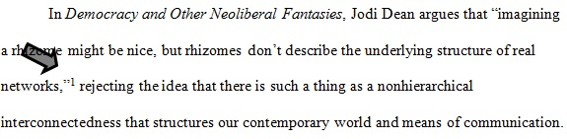
Source Citations: In-Text NB (con’t)
Formatting notes:
Place note numbers at the end of the clause or sentence to which they refer. (After any and all punctuation except the dash.)
Begin note numbers with “1” and follow consecutively throughout the paper.
Note reference numbers are set as superior (superscript) numbers in the text.

Slide 26
Source Citations: In-Text NB (con’t)
A complete “note” citation for a book, which corresponds to a slightly differently formatted bibliography entry, would look like this:
1. Jodi Dean, Democracy and Other Neoliberal Fantasies: Communicative Capitalism and Left Politics (Durham: Duke University Press, 2009), 30.
Subsequent note citations can and should be shortened, using the author’s last name and a shortened version of the title. Subsequent citations of Dean would be shortened to:
  2. Dean, Democracy and Other Neoliberal Fantasies, 30.
Notes:
The bibliographic citation for Dean’s work would look as follows:
Dean, Jodi. Democracy and Other Neoliberal Fantasies: Communicative Capitalism and Left Politics.
Durham: Duke University Press, 2009.
For additional examples of note and bibliographic citations for a variety of media, please see http://owl.english.purdue.edu/owl/resource/717/01/, especially the CMS NB Sample paper, http://owl.english.purdue.edu/owl/resource/717/10/.

Slide 27
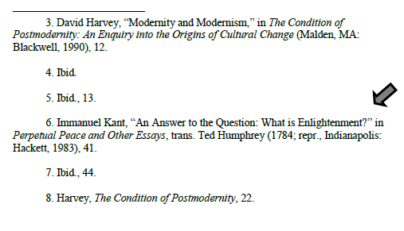
Source Citations: In-Text NB (con’t)
The first line of a footnote is indented .5” from the left margin. Subsequent lines, within a note, should be formatted flush left.
Leave an extra
line space
between notes.

Slide 28
Source Citations: In-Text NB (con’t)
When an editor’s or translator’s name appears in addition to an author’s, the former appears after the latter in notes and in the bibliography.
Bibliographic “Edited by” or “Translated by” should be shortened to “Ed.” and “Trans.” in notes.
  Plural forms, such as “Eds.,” are never used.
Ex.
6. Immanuel Kant, “An Answer to the Question: What is Enlightenment?” in Perpetual Peace and Other Essays, trans. Ted Humphrey (1784; repr., Indianapolis: Hackett, 1983), 41.
Notes:
The in-text note citation for Kant, here, is an example of a reprinted work. It’s complementary bibliographic entry would look as follows:
Kant, Immanuel. “An Answer to the Question: What is Enlightenment?” In Perpetual Peace and Other Essays, 41-48. Translated by Ted Humphrey.
1784. Reprint, Indianapolis: Hackett, 1983.

Slide 29
Source Citations: In-Text NB (con’t)
When a note contains both source documentation and commentary, the latter should follow the former.
Citation and commentary are usually separated by a period, but such comments as “emphasis added” are usually enclosed in parentheses.
Ex.
75. Lisa Ede and Andrea A. Lunsford, “Collaboration and Concepts of Authorship,” PMLA 116, no. 2 (March 2001): 354-69, http://www.jstor.org/stable/463522. Ede and Lunsford note that we all agree that writing is inherently social, yet we still rely on individualistic praxis; we still ascribe to pedagogies that encourage the independent author producing concrete (original, honest and “truthful”) works.

Slide 30
The End
The Chicago Manual of Style 17th Edition
Formatting Style Guide
Brought to you in cooperation with the
Purdue Online Writing Lab

Slide 31
Thank You
Purdue University On-Campus Writing Lab
Krach Leadership Center (2nd Floor)
Web: http://owl.english.purdue.edu/
Phone: (765) 494-3723
Email: owl@owl.english.purdue.edu
Notes:
Rationale: Purdue students are invited to meet with a tutor to assist with writing challenges on an individual basis. Viewers outside of Purdue may receive assistance through the OWL (Online Writing Lab) and answers to quick questions through the OWL email service.

