Slide 1
Scannable Résumés
Notes:
Rationale: Welcome to the “Scannable résumé Workshop.” This presentation is designed to assist students in learning the various methods for crafting a technologically correct document that will be successfully translated into a potential employer’s database. The slides presented here are designed to aid the facilitator in an interactive presentation of scannable résumés. This presentation is ideal for students who already have some working knowledge of general résumé writing and need to tailor their résumé for scanning. Furthermore, this presentation is beneficial to students who are nearing the time when they will be ready to apply for jobs or internships.
Directions: Each slide is activated by a single mouse click, unless otherwise noted in bold at the bottom of each notes page.
Writer: Stephanie Williams Hughes
Design Contributor and Updating Author: Allen Brizee, 2007; Angela Laflen and Jennifer Liethen Kunka; : Veronika Maliborska, 2014; Nina Taylor, 2023; Abby Thatcher, 2025
Developed with resources courtesy of the Purdue University Writing Lab
Grant funding courtesy of the Multimedia Instructional Development Center at Purdue University
© Copyright Purdue University, 2001, 2007

Slide 2
Roadmap
What is a Scannable Résumé?
Why a Scannable Résumé?
Electronic, Email, and Web Résumés
Lifecycle of the Scannable Résumé?
General Format
Dos and Don’ts

Slide 3
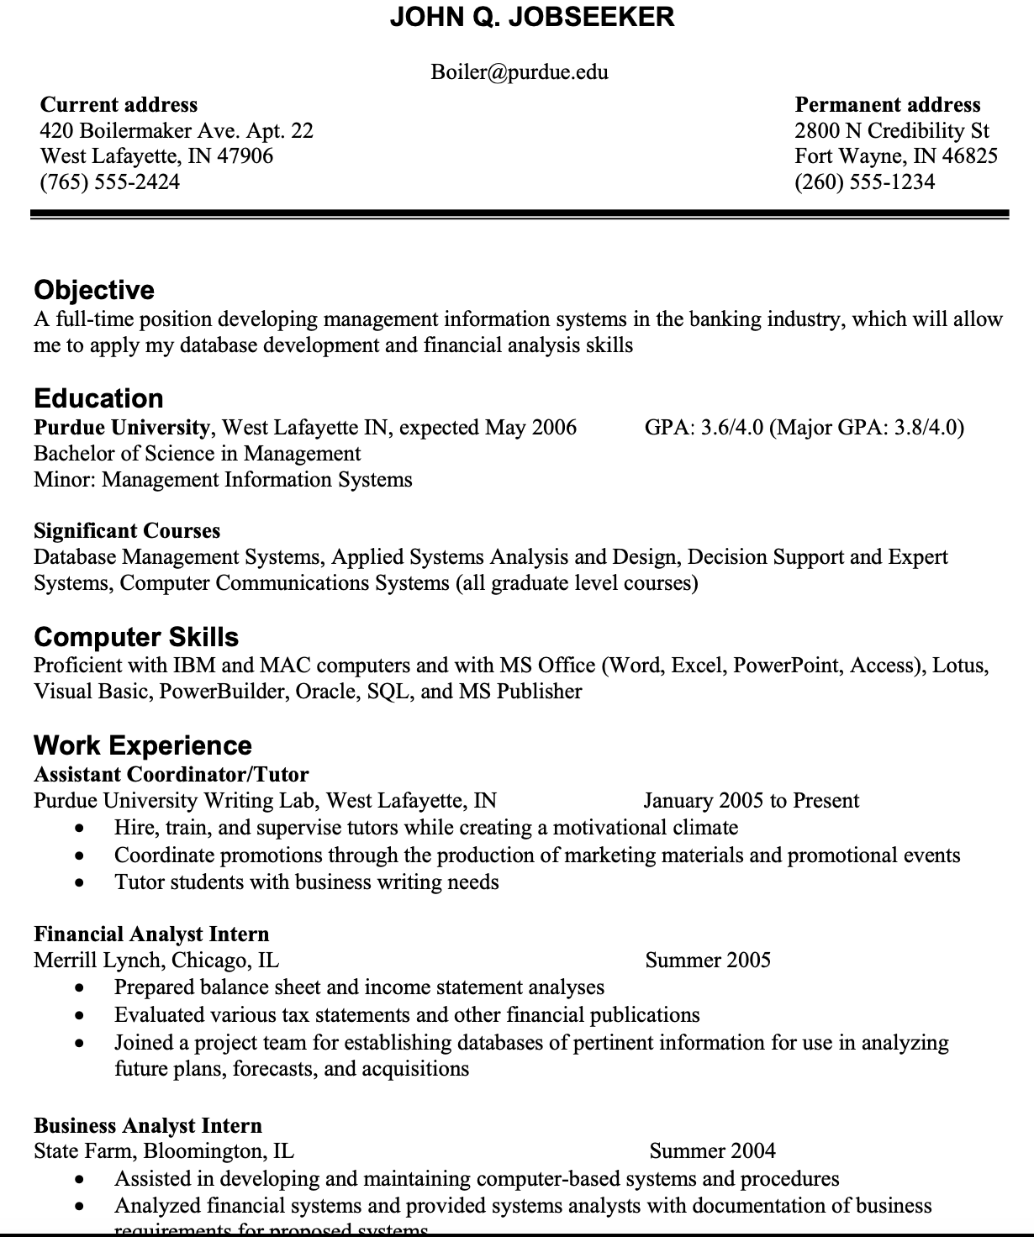
What is a Scannable Résumé?
A scannable résumé can be scanned into a computer using imaging technology.
It allows employers to search for applicants using keywords.
Notes:
Sample: https://owl.english.purdue.edu/owl/resource/547/1/
Key Concept: The facilitator should note that scannable résumés can still be as personalized as a traditional résumé. There is no one correct way to craft one; however, there are some basic formatting rules that, if broken, could render the résumé useless to the employer. The ideas suggested in this presentation are just a few approaches to creating a scannable.
As technology changes, scannables will change as well. It is important for résumé writers to remain aware of changes.
* This definition is from the scannable handout updated by Michelle Marrese at the Purdue University Writing Lab.

Slide 4
Why a Scannable Résumé?
Scannable résumé databases allow companies to search through a larger number of applicants.
Internet technology is more cost effective for employers; they do not need to spend as much time looking at résumés.
More and more companies are requiring applicants to forward a scannable résumé.
Notes:
Key Concept: There is some disagreement about the statistics for the number of companies using scannables. It is well above 80%. Technology students should certainly anticipate that their employers are using the most recent methods for their searches.
Employers are able to increase the diversity of their applicants by maintaining a database. This means that applications can remain on file for longer periods of time.
It also costs less for the company because managers are not required to spend as much time searching through pages of résumés. Instead, they can type in keywords to get a list of applicants.
Citation:
Bernard Haldane Associates. Haldane’s Best résumés for Professionals.
Manassas Park, VA: Impact Publications, 2000.

Slide 5
Electronic, Email, and Web Résumés
Electronic Résumé
A résumé that is written into a text box provided by the company or job search site
Generally written in very simple text and saved as an ASCII or text-only file
Email Résumé
A résumé that is written in plain text and can be sent as an attachment or in the email frame
Web Résumé
A résumé that is published onto a web site or page using graphics and hypertext
Notes:
Key Concept: It is important to have a clear understanding of the differences between scannable, electronic/email, and web résumés. It is generally recommended that applicants have three types: traditional, scannable, and electronic.
Electronic: Author Bernard Haldane calls the electronic résumé the “ugly duckling” because its purpose is strictly to convey the qualifications of the applicant. The electronic résumé is written in plain text (ASCII) and may have some punctuation.
Writers should hard return after each line to prevent odd spacing between sections. Generally, these are no longer than 65 lines. Some experts recommend that the sentences not be longer than 65 characters across.
Email: There are some who attempt to send email résumés as an attachment. This is fine as long as the applicant is certain the employer uses the same software. Writers should also avoid cutting and pasting from a word processing document because it will most likely be incompatible with email formats.
The applicant should save and send the email as a plain text file. Also, before forwarding the email to an employer, they should send it to themselves first to proofread and look for any formatting concerns.
Web résumés: A web résumé is a document that is published onto a web site. Many applicants have home pages and create a space for their résumé. University organizations tend to have web space available for their members to upload their résumés, and some academic departments offer this service.
Web résumés can be longer than one page because of their basic structure. While much more information can be included on a web résumé, including graphics and pictures, it should not be so long that it takes the employer longer than necessary to reach all the important information about the applicant’s qualifications. As with all other aspects of writing, being considerate to the needs of your audience remains the golden rule of creating web résumés. Web résumés should not include links that may place the applicant in a negative light.

Slide 6
Lifecycle of the Scannable Résumé?
Once it reaches the company, it is scanned into a database. The computer takes a picture and creates another version.
A software like ResTrack or Resumix extracts words and dates from the new version that can be searched by employers.
Notes:
Key Concept: Writers should be aware that their scannable résumé can go through several different people and be entered into a database before someone actually reads it. Some organizations do not own scannable software and hire special companies to maintain that data for them. When that is the case, employers can access the database via the Internet to do a keyword search for potential candidates.

Slide 7
Formatting and Submission Guidelines
General Format
Avoid Punctuation
Without Punctuation
Font and Typestyle
Addresses
Use Nouns Instead of Active Verbs
Keywords

Slide 8
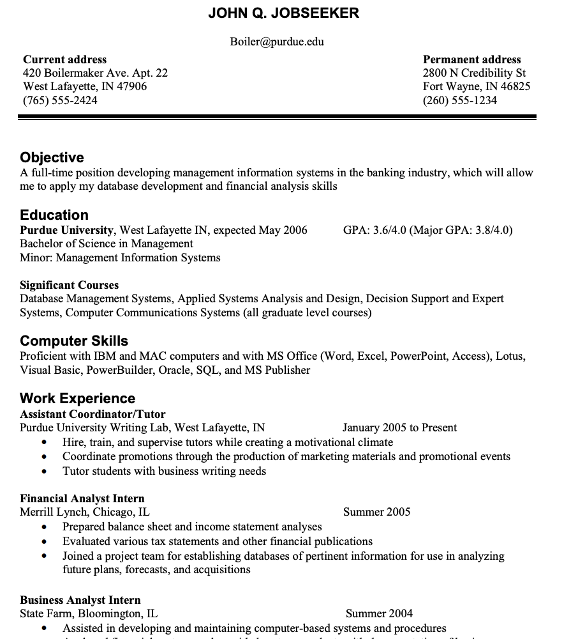
General Format
Left justify the entire document
Avoid punctuation as much as possible
Avoid vertical and horizontal lines, graphics, and boxes
Do not fold or staple
Use only those abbreviations that are familiar with your field of study
Notes:
Key Concept: This example is not intended to intimidate applicants but more to show why it is important that they take special care when constructing a scannable résumé.
Punctuation: When the word leader is used with a comma [leader,], the scannable will read it as one complete word when it takes the first picture. When the software steps in to extract the information, it will not understand the word ‘leader,’ and it will be deleted or garbled.
Lines and graphics: Lines and graphics will not be translated properly. The software will replace them with characters like !@#$%^%^&&**(.
When the résumé is scanned after being stapled, the wholes may “confuse” the scanner and think those are words or letters. The crease from where the paper was folded will read as a line which will read as $%^&*()+. Writers should try and avoid using course paper. The hairs of the paper, if bold enough, will be scanned, making it unreadable.
Citation: Weddle, Peter D. Internet résumés. Manassas Park, Va: Impact Publications, 1998.

Slide 9
Avoid Punctuation
If the computer is conducting a word search, it might not recognize the word leader if it is presented as leader.
No piece of punctuation should ever touch a word.
Notes:
Key Concept: There is a myth that the scannable résumé must look dramatically different from the traditional résumé. Instead, it should just be an alteration of a previously prepared traditional one.
Applicants still need to emphasize their skills, experience, education, etc. The only difference is the way the information is presented. Later slides will introduce some of the methods to use.

Slide 10
Without Punctuation
Punctuation can affect the employer’s ability to find matching terms in a keyword search.
CAREER OBJECTIVE
A position in business management with an interest in computers and banking emphasizing management information systems teamwork and customer service
Notes:
Key Concept: This slide is to illustrate a well scanned résumé with no punctuation problems

Slide 11
Font and Typestyle
Use fonts like Times New Roman, New Century, Courier, Helvetica, and sometimes Palatino
Font size should be between 10-12
Avoid fancy font styles such as italics, underline, and shadows.
Boldface and CAPITAL letters are acceptable provided that the letters do not touch each other
Provide white space between words
Avoid condensing the spaces between letters and lines
Notes:
Key Concept: The main point to focus on is that traditional fonts should be used, and fancy typestyles should be avoided. Experts have varying opinions about what types of fonts to use. The best way to judge is to be sure it is a font where the letters do not touch each other.
Sometimes writers will condense the spaces between lines in an effort to get more on the page. This is not recommended because the lines could bleed into each other.
When in doubt, use Times New Roman.

Slide 12
Addresses
Include an address for several reason:
Lack of an address can be read as a read flag and the employer may wonder whether you have something to hide
Offering an address increases your credibility
An address can help the employer to consider if relocation is needed
Some employers may request your address
When Including your address also consider privacy issues and biases.
Include a general address for delivery
Include city and state
When including more than one address, place one on top of the other. Using side by side columns will cause the lines to be misplaced and garbled
Campus Address
Ernest Hemingway
Young Graduate
House 2A
West Lafayette, IN
47906
765-494-3723
Home Address
Ernest Hemingway
2000 Sunshine Blvd.
Fisherman’s Way,
USA
555-555-5555
Notes:
Key Concept: Columns or newsletter type formats are appealing to the eye but not to a scanner. It will not be able to tell when a new line ends, and another begins. The lines will be misplaced into other parts of the text or garbled into computer hieroglyphics that is not readable.

Slide 13
Use Nouns Instead of Active Verbs
For example, if an employer is looking for a “graphic designer” that created “brochures” and “multimedia presentations”
Conventional résumé
Developed promotional materials and brochures,
created multimedia presentations, …
Scannable résumé
Graphic designer creating four color brochures multimedia presentations and newspaper ads
Graphic Designer ABC Creative Studio, New York, NY Summer 2021
Graphic designer creating four color brochures multimedia presentations and newspaper ads
Notes:
Key Concept: Columns or newsletter type formats are appealing to the eye but not to a scanner. It will not be able to tell when a new line ends, and another begins. The lines will be misplaced into other parts of the text or garbled into computer hieroglyphics that is not readable.

Slide 14
Keywords
Keywords are the most important aspect of a scannable résumé.
Applicant Tracking Systems (ATS) and recruiters often search for these specific terms to determine whether a résumé matches a job description.
Mirror the language from the job posting — use the exact phrasing where possible.
Focus on nouns and noun phrases rather than long sentences, as ATS systems scan for these terms.
Include a mix of hard skills (technical abilities) and soft skills (leadership, collaboration, communication) if they appear in the posting.
Industry-specific terms
Skills and competencies
Certifications or technologies
Place keywords naturally throughout headings, job titles, and bullet points in your work experience section.
Notes:
Key Concept: Aside from the structural parts of the scannable résumé, keywords are the most significant difference between a traditional and scannable. Applicants should include are pertinent keywords for their industry when demonstrating job-related skills.
Activity: Job seekers can speak with professors, look through textbooks, industry/trade magazines, and the Internet to find keywords that can be woven into their résumé.

Slide 15
Examples of Keywords
Keywords for a mechanical engineer | Using them as nouns
Manufacturing | Manufacturing Supervisor
Design | Design Assistant
Production | Production Manager
Injection | Injection Molding Inspector
Assembly Line/ Assemble Machines | Assembly Line Supervisor

Slide 16
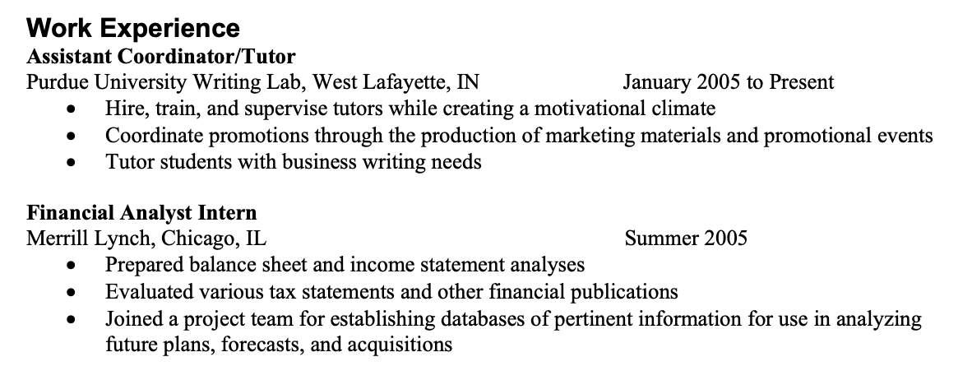
Experience Example
Manufacturing Intern
Wabash National 1998 2000
Production assistant for quality assurance
Injection molding inspector
Machine assembly

Slide 17
Keyword Summary
It can be included on a second page or in place of the skills statement at the top of the résumé
Category | Keywords for a person seeking entry level position
Education | • Bachelor of Science • Systems Engineering
Technical Areas | •Power Engineering • Human–Machine Interface (HMI) •Maintenance Subsystem Design • Maintenance •Procedures • Systems Integration • Process • Improvement
Professional Experience | •Consulting Firm Experience • Municipal Utility Operations • Research & Analysis • Data Analysis
Management & Operations | •Staff Management • Budget Management • Inventory Control • Small Business Operations
Career Level & Skills | •Entry-Level Engineering • Technical Problem Solving • Team Collaboration • Project Coordination
Notes:
Key Concept: These keywords are a summary of several different internships and job experiences. A skills statement or summary of qualifications generally is not used in conjunction with the keyword summary.
This is a feature that can be applied based on the writers’ preference. There are different opinions about the keyword summary. Some experts believe that if the experience section is properly developed then there is no need for a keyword summary. Other experts like Donald Asher believe that a scannable résumé must have one to increase the chances of a match.
Citation: Weddle, Peter. Internet résumés. Manassas Park, VA: Impact Publications, 1998.

Slide 18
Dos and Don’ts
Important Reminders
What to Avoid
Where Can I Get Help?

Slide 19
Important Reminders
You still want your résumé to be organized in a way that emphasizes your strengths.
Keep your skills, experience, education, honors/activities, and objective statement or summary of qualifications.
Notes:
Key Concept: There is a myth that the scannable résumé must look dramatically different from the traditional résumé. Instead, it should just be an alteration of a previously prepared traditional one.
Applicants still need to emphasize their skills, experience, education, etc. The only difference is the way the information is presented. Later slides will introduce some of the methods to use.

Slide 20
What to Avoid
A scanned conversational resume
Work Experience
Assistant Coordinator + Tutor @ Purdue Writing Lab (Jan ‘05 – now) • Hired + trained tutors & made sure everyone vibed w/ a motivating team culture • Helped get the word out: made flyers, ran promo events, all that good stuff • Tutored biz writing + helped students sound pro + clear in their work
Financial Analyst Intern @ Merrill Lynch, Chicago (Summer ‘05) • Dug into balance sheets + income statements 📊 • Reviewed tax docs + financial reports • Worked w/ a project team 💻 to build databases for future plans + forecasts
Notes:
Key Concept: This is an example of a résumé that was written without keeping in mind some of the formatting precautions.
The main problem with this sample is the choice of font. When the scanning software does not recognize certain letters, or the letters touch each other, it replaces the closest example it can find. So for instance, “expen’eiice” and “@rorimental” are places where the software found incorrect replacements.
Also, paper color can create these problems. If a writer uses gray paper and black ink, the scanner may not be able to see the print clearly.
Activity: Have the audience pick out problem areas and try to discern why that may have occurred. This is also a great opportunity for the speaker to engage the audience. It also helps to reveal how knowledgeable some participants are about scannable technology.
Citation: Weddle, Peter D. Internet résumés. Manassas Park, Va: Impact Publications, 1998.

Slide 21
Where Can I Get More Information About the Job Position?
Contact the company
Human resource departments are excellent resources for your résumé information.
It is acceptable to contact them. They may provide you with specific formatting instructions for scannable résumés.
Notes:
Key Concept: Job seekers are generally uncomfortable with calling the human resources department where they are applying. However, many times HR managers are excellent resources. They may have a preferred format for scannables that can take away a good portion of guesswork and anxiety from the writer.
Activity:
A few websites that participants can visit for more information on scannables:
a. www.monster.com
b. The Riley Guide www.dbm.com/jobguide/erésumé/html.

Slide 22
References
Schall, J. (2014). Computer Scannable Resume. College of Earth and Mineral Sciences, The Pennsylvania State University. https://www.e-education.psu.edu/styleforstudents/sites/www.e-education.psu.edu.styleforstudents/files/file/chapter%208/Resume4_new.pdf
Purdue OWL®. (2006). What is a Scannable Résumé? Purdue OWL® -Purdue University. https://owl.purdue.edu/owl/job_search_writing/resumes_and_vitas/scannable_resumes/index.html
USAJOBS. (n.d.). Update your resume now so it meets new resume requirements. USAJOBS Help Center. Retrieved November 6, 2025, from https://help.usajobs.gov/faq/application/documents/resume/page-limit

Slide 23
Thank You
Both the Online Writing Lab and On-Campus Writing Lab are great resources to support you in visual rhetoric like PowerPoint. You can discuss your presentation with a trained consultant at any stage of the process.
Schedule an Appointment:
The second floor of Krach
owl.purdue.edu
(765) 494-3723

