Slide 1
Data Visualization Best Practices

Slide 2
Determining Display Type
Though it can be tempting to use flashy or novel visual presentation tools, consider the best display method for your information:
Information Type | Effective Presentation
Numeric | Tables, charts
People, objects | Pictures, line drawings
Processes | Flow charts
Geographic data | Maps
Nonchronological lists | Bulleted lists
Chronological or prioritized lists | Numbered lists
Notes:
Do not be persuaded by fancy 3D or animated visuals– readers can struggle to interpret data when the presentation type of complex, moving, or novel. Simple, universal presentation tools are often best to reach a wide audience of readers.

Slide 3
3Es of Displaying Data
Effective
Ethical
Efficient

Slide 4
Effective Display
Assure that the visual is placed within proximity to the text and vice versa.
Visuals give readers opportunities to pause and consider the ideas in the text.
Graphics visually reinforce your argument; readers tend to trust what they can see.
Tell a simple story with your data.
Notes:
Do not make your reader flip through pages or go searching for data.
Do not overcrowd with too many visuals, design elements, or colors
Reinforce the written text, do not replace it
Label and properly place your graphical information—this includes appropriate captions, figure titles, and graphic titles.

Slide 5
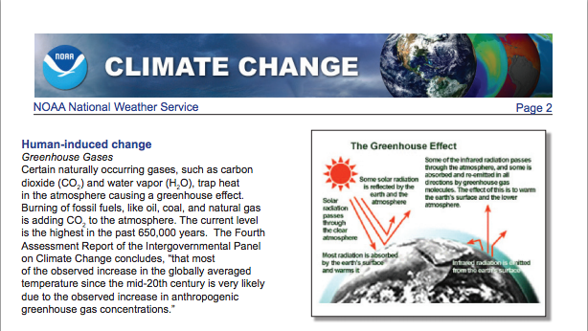
Example
Evaluate the following graphic
What is effective about the placement of this graphic?
What could be made more effective in the layout and composition of this page?
How might these suggestions change from print to screen audiences?
Notes:
Though this principle might seem obvious, assure that your text compliments your graphics and vice versa. Graphics should appear on the page where they are discussed. Graphics should be properly titled to better foster reader understanding and navigation.
In the example above, what is effective about the placement of this graphic? What could be made more effective in the layout and composition of this page?
How might these suggestions change from print to screen audiences?
Graphic via: NOAA National Weather Service semi-annual report on climate change. http://climate.nasa.gov/causes/

Slide 6
Ethical Display
Be absolutely honest with your readers.
Do not be tempted to exaggerate trends or inflate results.
If you did not create the graphic or generate the data, cite your source.
If you want to publish a graphic that you did not create, obtain permission.
Notes:
Unethical graphics can erode the credibility of an entire document– assure that you follow these ethical display options and double check your visualization before presenting information to your readers.

Slide 7
Ethical Display
Include all relevant data.
  For instance, if you have a data point that you cannot explain, do not change the scale to eliminate it.
Represent quantities honestly.
Do not use a table to hide a data point that would be obvious in a graph.
Do not use color to misrepresent an item’s importance.
  Shade can trick the eye to make elements larger than darker shaded items of the same size.
Notes:
Also of note, be careful when using color to emphasize item importance; Shade can trick the eye to make elements appear larger than darker-shaded items of the same size.

Slide 8
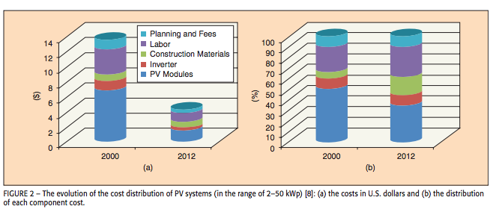
Example
Evaluate the following graphic
What ethical issues do you notice about this graph?
How might the manner in which the information is displayed misinform readers?
What suggestions would you offer to improve the way this data is displayed?
How might you revise this graph to be more ethical?
How does color change the data and reader reception?
Notes:
What ethical issues do you notice about this graph? How might the manner in which the information is displayed misinform readers?
What suggestions would you offer to improve the way this data is displayed? How might you revise this graph to be more ethical?
How does color change the data and reader reception?
This particular example skews the data through the 3D presentation of the graph, which can complicate readers’ perception and interpretation of the data. The Y axis is hard to read because of the 3D skew of the lines on the chart and the shades of blue on this graph are too similar to accurately tell the data portions apart.
Graphic via: Kouro, S.; Leon, J.I.; Vinnikov, D.; Franquelo, L.G., "Grid-Connected Photovoltaic Systems: An Overview of Recent Research and Emerging PV Converter Technology," in Industrial Electronics Magazine, IEEE , vol.9, no.1, pp.47-61, March 2015

Slide 9
Efficient Display
Use color carefully and sparingly.
Avoid color when black and white are more effective.
Use color to establish visual patterns, but limit it to two or three colors for clarity.
Notes:
Often, using black and white is more efficient depending on publication guidelines and requirements.
Tip: Use colors for small items, such as portions of graphics, annotations, and important words.
Graphic via: Kouro, S.; Leon, J.I.; Vinnikov, D.; Franquelo, L.G., "Grid-Connected Photovoltaic Systems: An Overview of Recent Research and Emerging PV Converter Technology," in Industrial Electronics Magazine, IEEE , vol.9, no.1, pp.47-61, March 2015

Slide 10

Color & Contrast
Color sets with strong contrast (on screen and in print)
White or neutral backgrounds with bold, warm text or annotation colors provide the strongest contrast.
Notes:
The same colors will look different considering the colors they are matched with. Sometimes they will be dulled, and sometimes they will pop out even more.
This effect will become very important to keep in mind when choosing text and background colors for your design.

Slide 11
Best Contrasting Colors
Strong Contrast. Best for visual annotations or charts on screen.
Strong Contrast. Stick with the basics- black & white.
Notes:
Yellow against a black background is best for text on screen– the combination assures that readers can see it from afar, especially when used in a sans serif font.

Slide 12
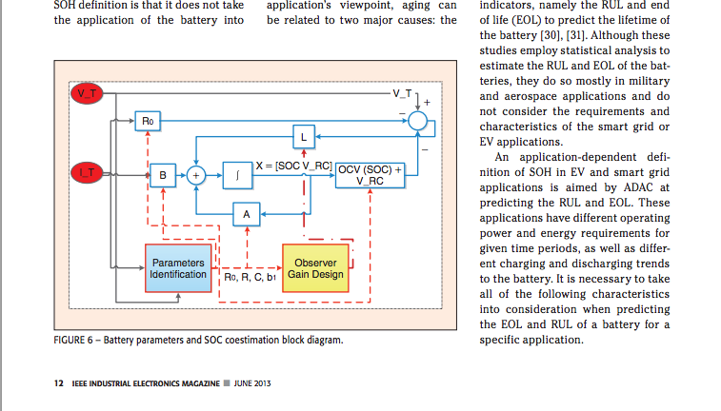
Example
Evaluate the following visual
Does the following graphic create an effective or ineffective contrast?
Does the use of color make the visual easier to interpret? Why or why not?
Notes:
In Example 3, consider the use of color in this visual. Does it create an effective or ineffective contrast? Does the use of color make the visual easier to interpret? Why or why not?
Graphic via: Rahimi-Eichi, H.; Ojha, U.; Baronti, F.; Chow, M., "Battery Management System: An Overview of Its Application in the Smart Grid and Electric Vehicles," in Industrial Electronics Magazine, IEEE , vol.7, no.2, pp.4-16, June 2013

Slide 13
Grayscale and Texture
Gray scale: take advantage of texture options in graphics, such as lines, dots, or hash marks.
Tip: it’s handy to view your color graphics in gray scale as you work to assure that your graphics represent the data well, taking care to make sure no two colors are similar or muddied.
Notes:
Texture can help readers differentiate points of data when color is absent, such as in a publication where using color is either expensive for printing purposes or not allowed in the publication guidelines.
To test your visualization in gray scale, use the color and picture formatting settings in your program of choice.

Slide 14
Layout and Typography
Your data visualizations will likely be presented alongside text, or work in concert with text such as titles, subtitles or labels.
When working with these elements, the following tips provide general approaches for assuring readers can easily access, read, and interpret the information you provide in your data visualizations.
Notes:
Additionally, be sure to consult any publication or presentation guidelines from a journal or conference if you are seeking to publish or present your data visualizations. Often, many of these organizations will have templates, tips, or protocol for pursuing layout and typography issues.

Slide 15
Layout
HATS Principles & Effective Integration of Visuals
Headings: Promote easy navigation
Access: Promote the finding and understanding of information.
Typography: Promote the ease of reading and clear levels of information hierarchy
Space: Promote effective document design.
Notes:
A memorable acronym to follow and use to assure your documents begin to follow proper design principles is HATS.
Headings:
Typeface, size, styles, and alignment show different levels of importance and detail.
How can headings best be used to draw attention to data visualizations on articles and presentations/handouts?
Access:
Captions, labeling, and best practices for usage of color, texture, and shade fall under access considerations as well.
Limit text and provide ample space for access of text or information in presentations.
Typography:
Avoid using more than two types of font in one presentation, document, or graphic. Multiple fonts can distract readers from your data and disrupt any visual structure you have created to signal consistent design elements in your work.
Assure you can read all text against your slide or graphic’s background
Space:
Work in harmony with margins and be familiar with text wrap settings
Allow for space around visuals rather than using frames, unless an edge of your visual bleeds into the white space of a page (i.e. the margin)
Do not crowd visuals with words. Trust your eyes when you step back to view the page at a distance.

Slide 16
Thank You
Purdue University On-Campus Writing Lab
Krach Leadership Center (2nd Floor)
Web: http://owl.purdue.edu
Phone: (765) 494-3723
Notes:
Purdue students in West Lafayette, IN may visit the On-Campus Writing Lab in Krach Leadership Center, 2nd Floor. Worldwide users may visit the Purdue OWL to access a large library of writing resources.

